Slide 1
IANA Activities Update
Jean-Jacques Sahel | RIPE 70 Amsterdam| 15 May 2015

Slide 2
Agenda
Policy Implementation
RDAP Implementation
Audits
Performance Reports
Notes:
RDAP:
Registration Data Access Protocol

Slide 3
Global Policy Implementation Experience

Slide 4

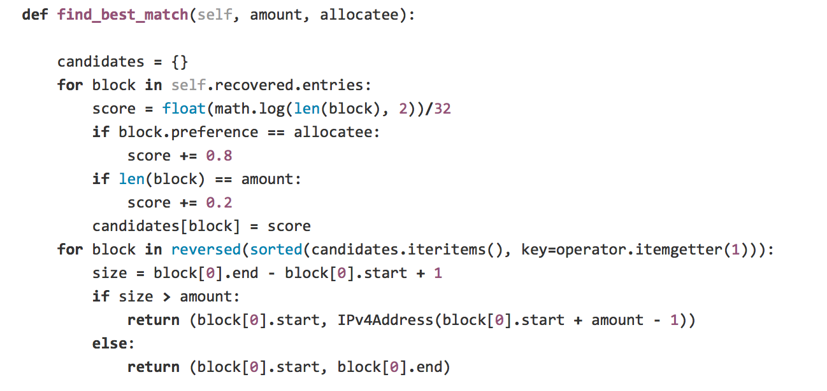
IPv4 Allocation
Allocate twice per year
Allocations happen on a pre-defined schedule
Use published software tool
ICANN publishes the software used to make selection as open source available for anyone to inspect
github.com/icann/ipv4-recovery-algorithm

Slide 5
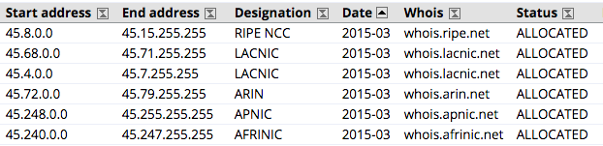
March 2015 Allocation
Third allocation under global policy made on 2 March 2015 in-line with ASO AC advice
Each RIR received 524,288 IPv4 addresses (a /13 equivalent)
http://www.iana.org/assignments/ipv4-recovered-address-space

Slide 6
AS Numbers
ASO AC advice on allocation of ASN blocks to RIRs received on 3 September 2014
At the time, only 496 16-bit AS numbers were available
Advice clarified that an RIR can request a block (1024 numbers) that is made up of a specified number of 16-bit numbers and 32-bit numbers
Since then, 297 16-bit AS Numbers have been allocated to APNIC, LACNIC, and ARIN
IANA has 199 16-bit ASNs remaining

Slide 7
Registration Data Access Protocol (RDAP) Update

Slide 8
RDAP Update
RFC 7484 “Finding the Authoritative Registration Data (RDAP) Service” was published in March 2015
The IANA Department completed the creation of registries specified in the RFC
Currently working with the RIRs to design a process to add and maintain the RDAP entries in the relevant registries.
RDAP Entries apply to the following IANA Number Registries:
  IANA IPv4 Address Space Registry
  IPv6 Global Unicast Address Assignments
  Autonomous System (AS) Numbers

Slide 9

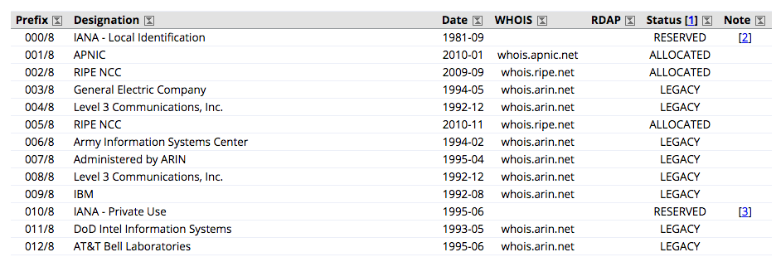
The above is a screen cap from the IANA IPv4 registry: http://www.iana.org/assignments/ipv4-address-space/ipv4-address-space.xhtml

Slide 10
Service Organization Control Audits

Slide 11
Service Organization Control Audits
ICANN recently retained the Service Organization Control (SOC) 3 certification of its Domain Name System Security Extensions (DNSSEC) Root key Signing Key systems for the fifth consecutive year
Also completed the second SOC2 audit, which evaluates key systems used to support IANA transaction processing functions
Undergoing independent audits helps assure we have appropriate internal controls in place to meet availability, processing integrity and security service levels for the IANA functions
Audits are conducted every year and help us to constantly monitor and improve our systems

Slide 12
Performance Reports

Slide 13
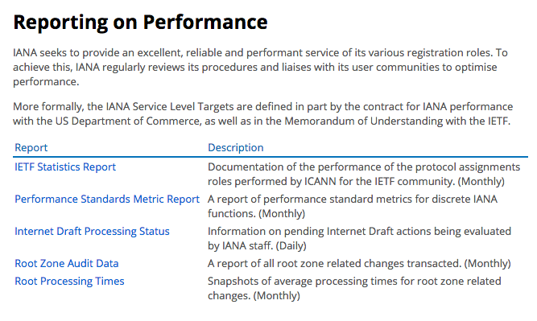
Performance Reports
Regular monthly reports are published at http://www.iana.org/performance
Performance standards were developed collaboratively with the community
We routinely meet or exceeds all performance targets

Slide 14
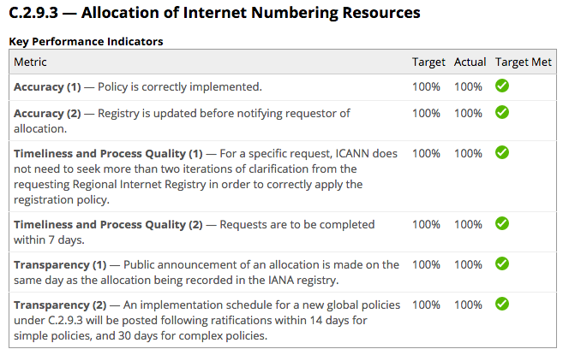
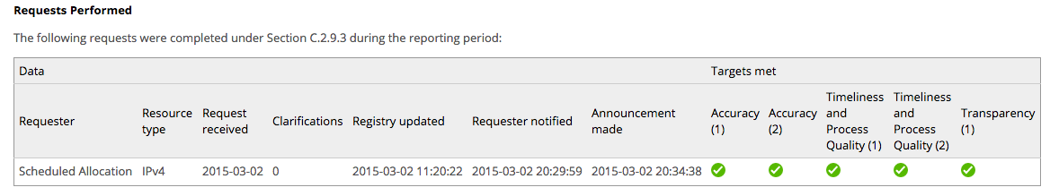
Allocation of Internet Numbering Resources

Slide 15
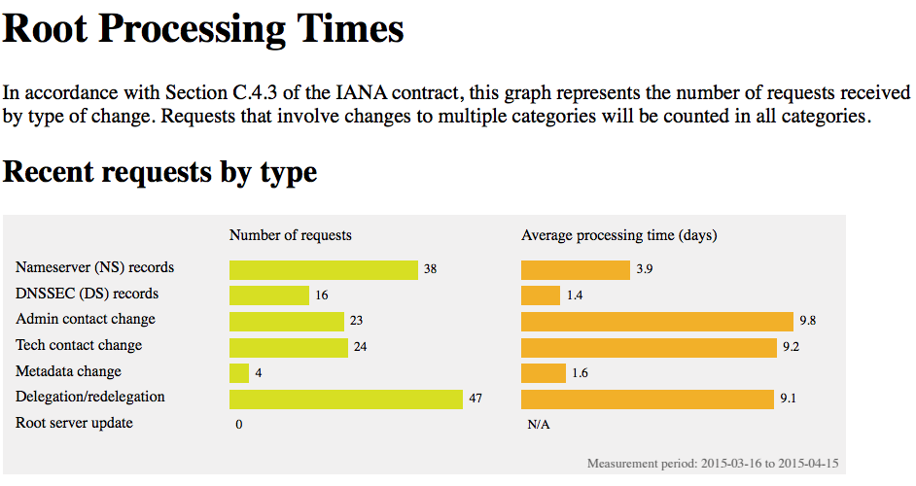
Root Zone Management

Slide 16








Engage with ICANN
Thank You and Questions
Reach us at:
Email: iana@icann.org
Website: icann.org
twitter.com/icann
gplus.to/icann
facebook.com/icannorg
weibo.com/ICANNorg
linkedin.com/company/icann
flickr.com/photos/icann
youtube.com/user/icannnews
slideshare.net/icannpresentations
Notes:
You can adjust the email/web address to

