Slide 1
Measuring Delay and Packet Loss at an IXP
Theory and Practice
RIPE 70
Christoph Dietzel
Junior Researcher / PhD Student

Slide 2
Agenda
Agreed Service Levels
History
Challenges
Implementation
Questions & Answers

Slide 3
Agreed Service Levels
Requirements:
One way delay: < 500 µs for up to 97.5% of the packets
Jitter: < 100 µs for 97.5% of the packets
Packet loss: < 0.05% on a daily average (24 hours)
All physical links must be covered
Graphs on the customer portal

Slide 4
SLA History
RIPE-TTM
Discontinued service in 2014
Accedian MetroNODE / MetroNID
Limitations regarding path selection (Y.1731 protocol)
Pricy for our use case
Custom implementation
Measure RTT
Delay := RTT / 2
Jitter := Avg. deviation of the mean latency [1]
Packet loss & all links covered: No loss at a representative number of packets over all links
[1] RFC 3393, http://tools.ietf.org/html/rfc3393

Slide 5
Challenges of Latency Measurement
Multiple paths from A to B on platform (how many?)
Limited control over LAG (Link Aggregation Group) and LAG member choice
Be nice, not too much bandwidth consumption
Platform and OS limitations (protocol stack delay)

Slide 6
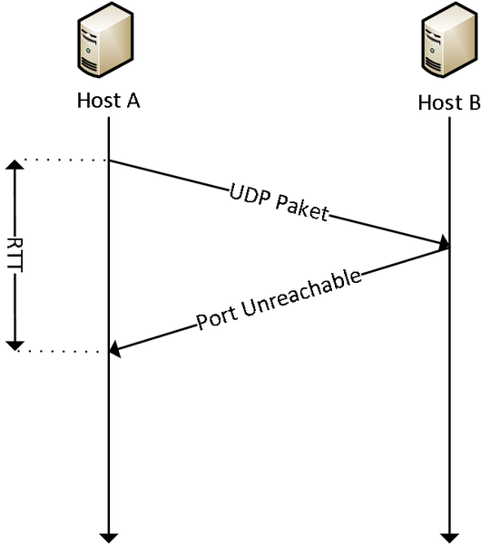
Measurement Tools
4 edge switches, 4 probing systems
Using UDP & ICMP (nping)
Unidirectional
12 sending instances (AB, AC, AD, BA, BC, BD, CA, CB, CD, DA, DB, DC)
How to verify success?

Slide 7
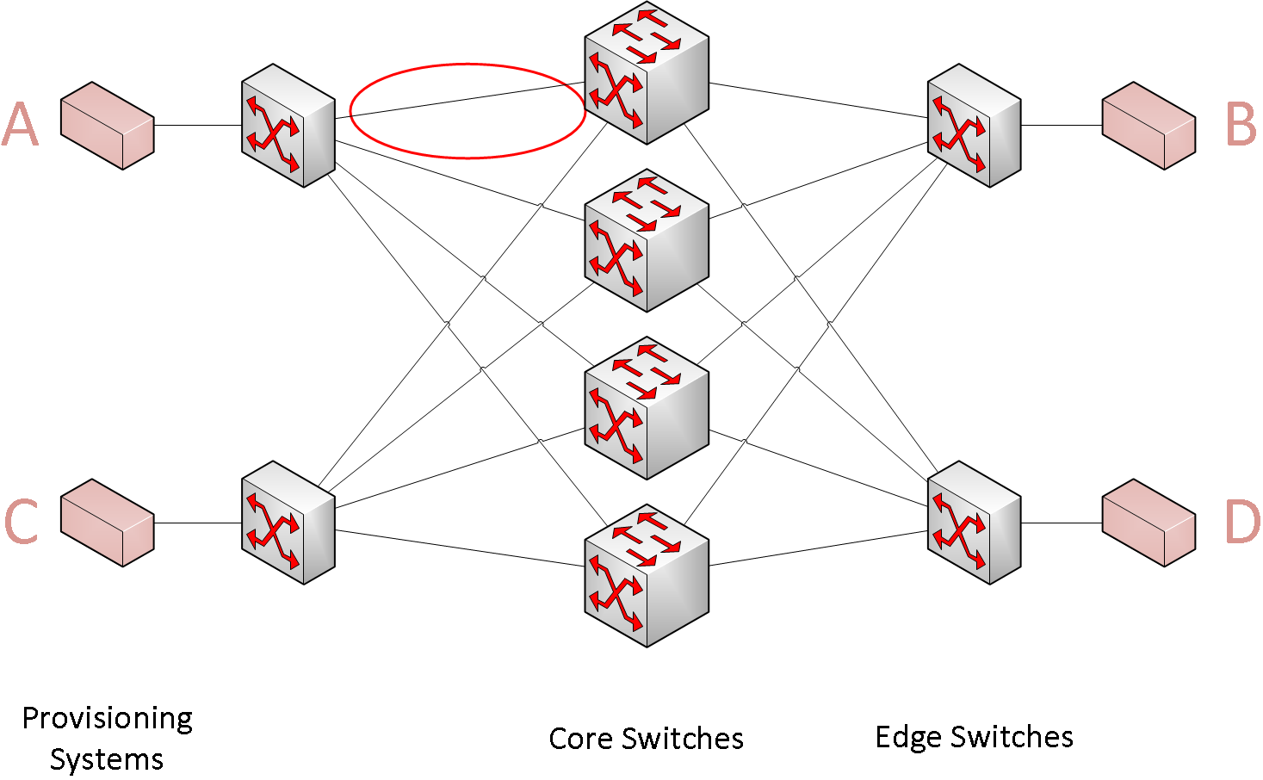
Number of Different Paths
DE-CIX LAG members

Slide 8
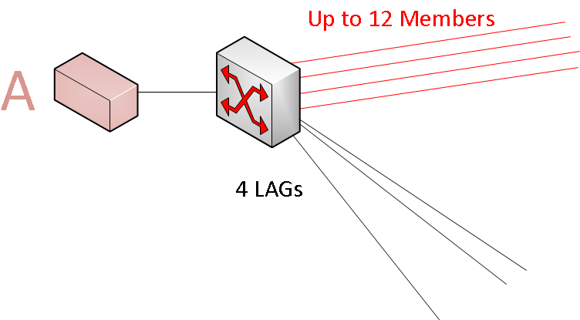
Number of Different Paths
DE-CIX LAG members

Slide 9
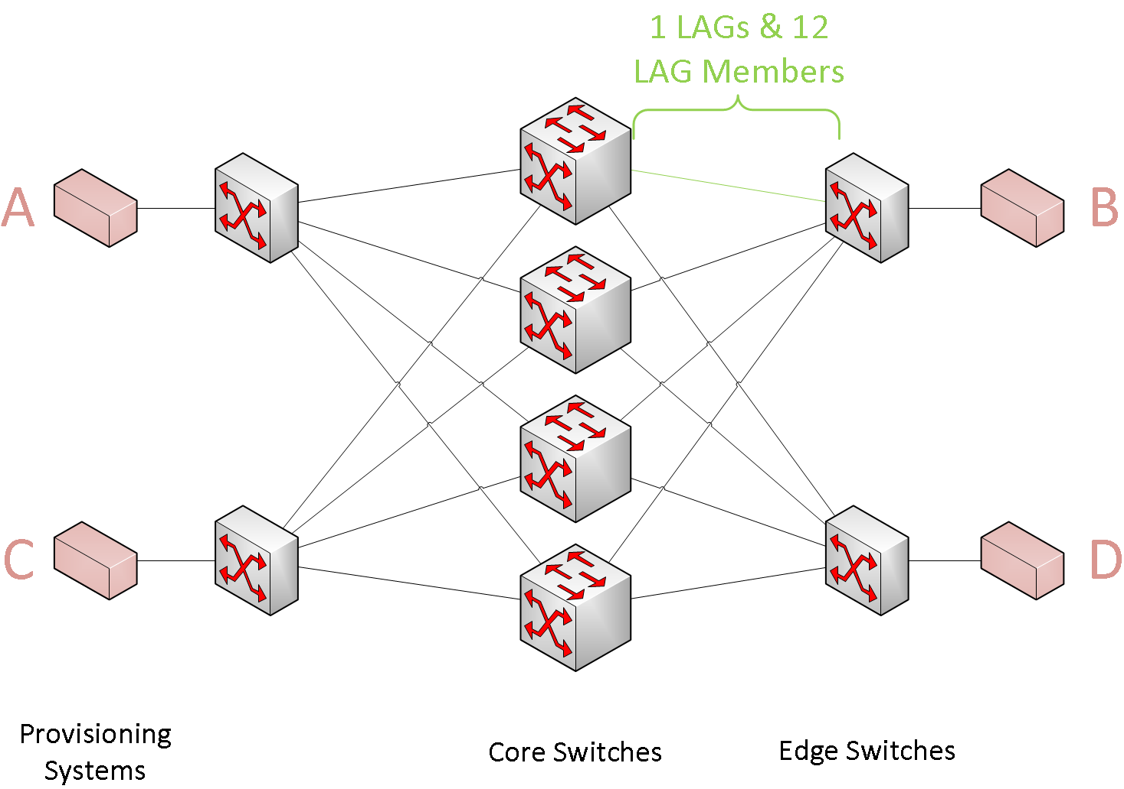
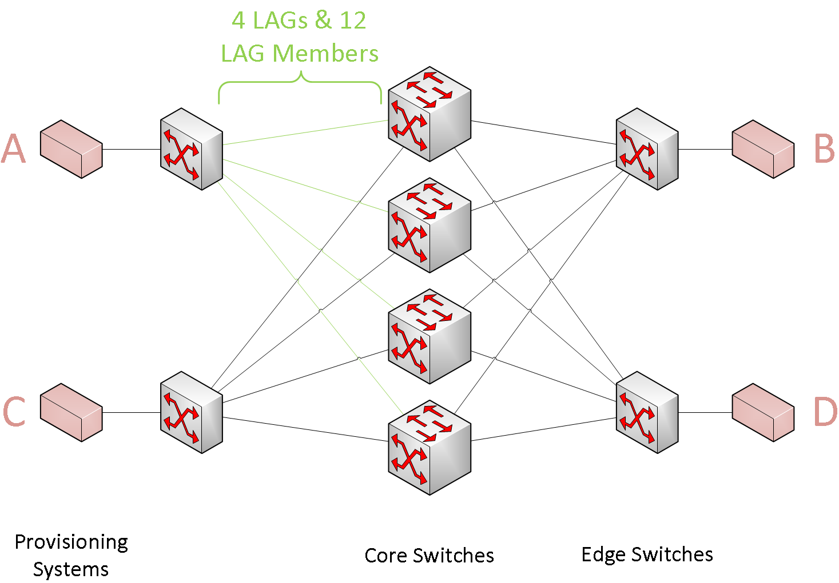
Number of Different Paths
Probe from A to B (unidirectional)
4 LAGs from edge to core, 12 members per LAG
1 LAG from core to edge, 12 members per LAG

Slide 10
Number of Different Paths
Probe from A to B (unidirectional)
4 LAGs from edge to core, 12 members per LAG
1 LAG from core to edge, 12 members per LAG
Probe from A to B, response from B to A not considered

Slide 11
Path Selection: LAG and LAG Member Choice
LAG choice
ECMP (MPLS/VPLS)
Assumption: equal chance for each LAG
LAG member choice
Hash space divided by LAG members
Hash {src mac, dest mac, src ip, dest ip, src port, dest port} -> deterministic path
mac, ip have to be immutable for a path A to B
port the only source of entropy ☹
Assumption: hash space is equally distributed over all LAG members
even though only the port is dynamic

Slide 12
Number of Probes to Test All Paths with 95% Certainty
Mathematical foundations: coupon collector’s problem
How many pictures must be bought to have the full set with a chance of 50%
How many pings must be send … maps to collectors problem
Certainty k = 0.95
Number of paths n = 576 (unidirectional)
Number of probes x = ?
Limit theorem [2]:
[2] Erdős, Paul; Rényi, Alfréd, On a classical problem of probability theory

Slide 13
Implementation
3 instances of nping at all 4 provisioning systems
nping --privileged -v0 -c 5372 --rate 1000 --udp -p $rand 192.168.1.2
Chose random port for each probe
$ports->{40000 + int(rand(25536))}
IP tables rule reduce protocol stack caused delay
iptables -I INPUT --proto udp --dport 40000:65536 -j REJECT
Disable ICMP kernel rate limit
echo 'net.ipv4.icmp_ratemask=6160' >> /etc/sysctl.conf

Slide 14
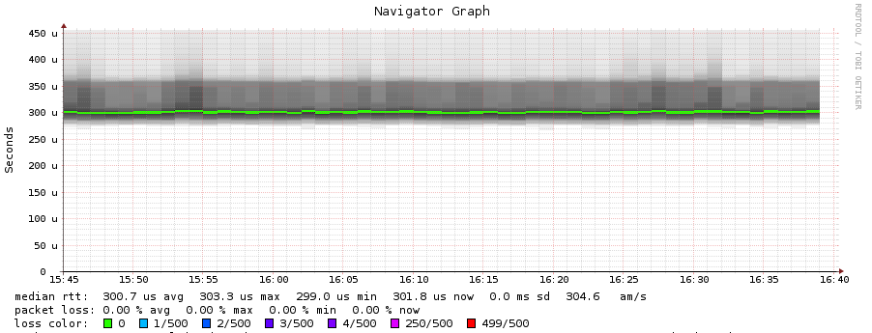
Customer View

Slide 15
DE-CIX Management GmbH
Lindleystr. 12
60314 Frankfurt
Germany
Phone +49 69 1730 902 0
rnd@de-cix.net

