Slide 1
OS IPv6 Behavior in
Conflicting Environments
Enno Rey & Christopher Werny
{erey,cwerny}@ernw.de

Slide 2
Who Are We
Old-school network guys with some background in large scale operations.
Involved with IPv6 since a loong time and regularly blogging about IPv6 at www.insinuator.net.

Slide 3


Agenda
Fundamentals
  Quick Refresher of Basics & Specifications
Results from the Lab
  Some Surprises (?)
Conclusions
  What All this Means from
  an Operations Perspective

Slide 4
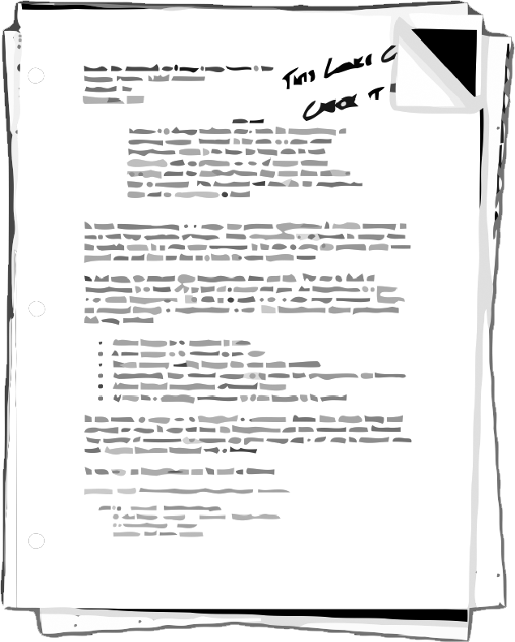
Related Work
[draft-ietf-v6ops-dhcpv6-slaac-problem]
  DHCPv6/SLAAC Interaction Problems on Address Auto-configuration. draft-ietf-v6ops-dhcpv6-slaac-problem-04
[draft-droms-dhcpv6-issues]
  Issues Concerning DHCP in IPv6 Specifications. draft-droms-dhcpv6-issues-00
  Expired Apr 27 2003 (!)
  https://tools.ietf.org/id/draft-droms-dhcpv6-issues-00.txt
https://tools.ietf.org/id/draft-ietf-v6ops-dhcpv6-slaac-problem-04.txt

Slide 5
Fundamentals
What the textbook tells you

Slide 6
Relevant Specifications

Slide 7


What Do the Specs Say?
Oh, that’s an easy one. Just look at the RFCs.
“The nice thing about standards is that you have so many to choose from.”
  This was funny, wasn’t it?
  Combine this with the culture of deprecation and out comes… a horrible mess.
Curtain up!
Andrew Tanenbaum

Slide 8
There’s Different Generations of IPv6 Stacks
Neighbor
Discovery
…
RFC 1970
RFC 2410
RFC 4861
RFC 6980
Address
Selection
…
RFC 3484
RFC 6724
Generation
of IID
…
EUI-64
Privacy Extensions
RFC 7217 et.al.
…
Etc.
◀ RFC XXX
◀ RFC XXX
◀ RFC XXX

Slide 9
RFC 2461
6.3.4. Processing Received Router Advertisements
When multiple routers are present, the information advertised collectively by all routers may be a superset of the information contained in a single Router Advertisement. Moreover, information may also be obtained through other dynamic means, such as stateful autoconfiguration. Hosts accept the union of all received information; the receipt of a Router Advertisement MUST NOT invalidate all information received in a previous advertisement or from another source. However, when received information for a specific parameter (e.g., Link MTU) or option (e.g., Lifetime on a specific Prefix) differs from information received earlier, and the parameter/option can only have one value, the most recently received information is considered authoritative.
Note: RFC 4861, 6.2.7 on "Router Advertisement Consistency" seems to state that "inconsistencies are ok, but should be logged, by nodes".

Slide 10

RFC 4861
Sect. 4.2
  “If neither M nor O flags are set, this indicates that no information is available via DHCPv6.”
If the M flag is set, the O flag is redundant and it can be ignored.

Slide 11

Some More Quotes
RFC 4862, 5.5.2 Absence of Router Advertisements
  “Even if a link has no routers, the DHCPv6 service to obtain addresses may still be available, and hosts may want to use the service.”
RFC 4862, 5.6 Configuration Consistency
  “If the same configuration information is provided by multiple sources, the value of this information should be consistent.”
  “In any case, if there is no security difference, the most recently obtained values SHOULD have precedence over information learned earlier.”
Not much RFC 2119 in there, is it?

Slide 12
RFC 6106
“1.2 Coexistence of RA Options and DHCP Options for DNS Configuration
Two protocols exist to configure the DNS information on a host, the Router Advertisement options described in this document and the DHCPv6 options described in [RFC3646]. They can be used together.
The rules governing the decision to use stateful configuration mechanisms are specified in [RFC4861]. Hosts conforming to this specification MUST extract DNS information from Router Advertisement messages, unless static DNS configuration has been specified by the user.
If there is DNS information available from multiple Router Advertisements and/or from DHCP, the host MUST maintain an ordered list of this information as specified in Section 5.3.1.

Slide 13
RFC 6106
In the case where the DNS options of RDNSS and DNSSL can be obtained from multiple sources, such as RA and DHCP, the IPv6 host SHOULD keep some DNS options from all sources.
Unless explicitly specified for the discovery mechanism, the exact number of addresses and domain names to keep is a matter of local policy and implementation choice.
However, the ability to store at least three RDNSS addresses (or DNSSL domain names) from at least two different sources is RECOMMENDED.
The DNS options from Router Advertisements and DHCP SHOULD be stored into the DNS Repository and Resolver Repository so that information from DHCP appears there first and therefore takes precedence.
Thus, the DNS information from DHCP takes precedence over that from RA for DNS queries.
Section 5.3.1

Slide 14
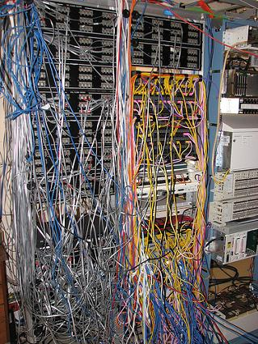
In Short
It‘s a mess!
At least on the specs level.

Slide 15

Problem Statement
From a High-Level Perspective

Slide 16

Problem Statement (I)
IPv6 provides two mechanisms for one task, that is provisioning of IP parameters to nodes.

Slide 17

Problem Statement (II)
They are independent.
  Well, mostly.
In many environments both of them are needed, in some combination.
  In particular this applies in (wrt OSs, devices) heterogeneous environments.
  Read: probably in pretty much all of your environments.
In some environments different groups might be responsible for operating them.
  Why did you add this to the “problem statement“? Well...
There‘s differences as for the degree of vendor support & their strategies.
There‘s two mechanisms

Slide 18
Problem Statement (III)
Some properties and elements have been enhanced over time,
e.g. RFC 6106.
  Evolution is a good thing. Seriously!
Still, there‘s a certain (alas, when it comes to IPv6: usual) amount of ambiguity and vagueness in the main RFCs.
Let‘s look at the specs...

Slide 19

Problem Statement (IV)
The “cooperation“ of those two mechanisms has been discussed quite a bit, both in the specs and in “the relevant fora“.
However, not so much as for scenarios where the information provided by them is conflicting.
This is what this talk is about.

Slide 20

Problem Statement (IV)
Human error
  Both on the active failure and latent failure level.
Conflicting/differing vendor default settings
  Network devices
  CPEs!
    Keep in mind: there might be any OS in customers‘ networks.
Attacker injecting nasty packets
  Boils down to “standard local-link sec“ discussion → we will only briefly cover this.
Can such (“conflict scenarios“) happen?

Slide 21

What's a "Conflict"?
#1: Both mechanisms are (maybe: somewhat) present, but only one is supposed to be used.
#2: Both mechanisms lead to address(es) on nodes.
#3: Both mechanisms distribute RDNSS in parallel, but different ones.
Once you think hard enough, you'll come up with many more variants.
Pls define!

Slide 22

Additional Observations
[draft-ietf-v6ops-dhcpv6-slaac-problem-04] explicitly discusses the role of state transitions.
We can confirm that these lead to particularly interesting effects.
  → Pay special attention in times when you perform those deliberately.
  Be prepared for surprises...
In general the order of events seems to play a role, too.
  See also test cases with two routers below.

Slide 23
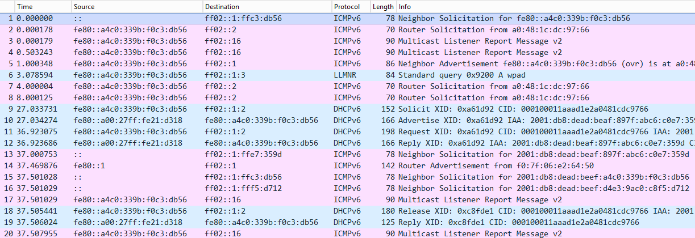
Why the Order Might Matter – Sample

Slide 24
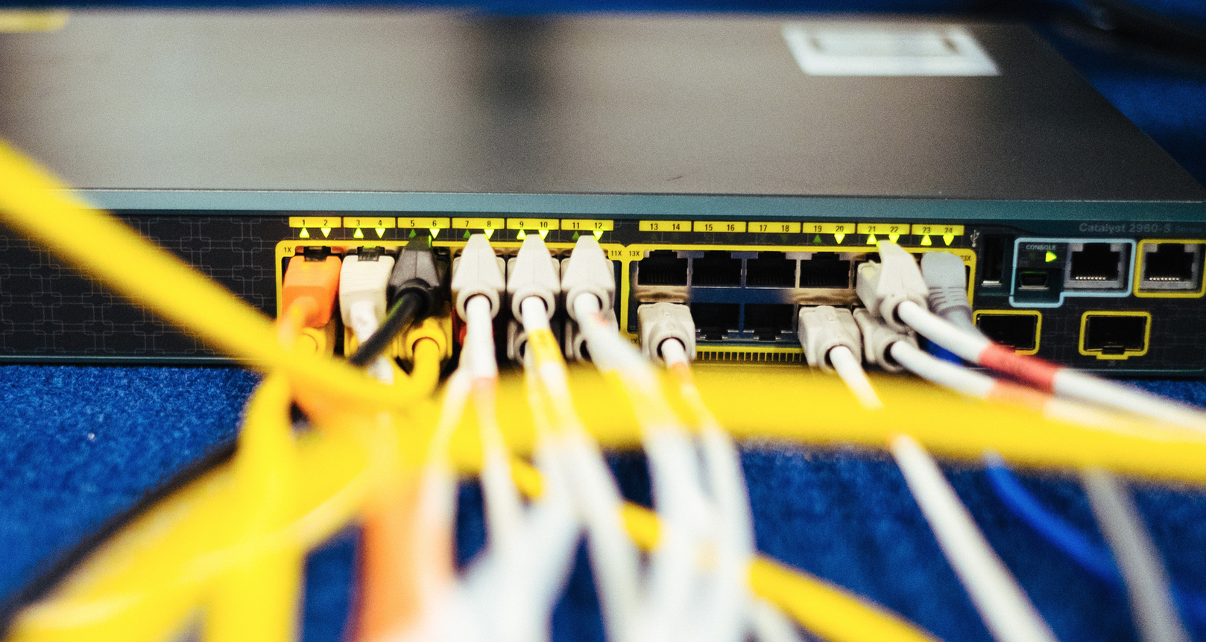
From the Lab

Slide 25

Lab Setup
A DHCPv6 Server (DHCP ISC Version 4.3.1) installed on CentOs 6.6 . The DHCPv6 server is configured to provide both IPv6 addresses and RDNSS information.
Two (2) routers Cisco 4321 using Cisco IOS Software version 15.5(1)S.
The following OS as clients:
  Fedora 21, kernel version 3.18.3-201 x64
  Ubuntu 14.04.1 LTS, kernel version 3.13.0-44-generic
  CentOS 7, kernel version 3.10.0-123.13.2.el7
  Mac OS X 10.10.2 Yosemite
  Windows 7, patch level Feb 2015
  Windows 8.1, patch level Feb 2015
See also:
https://www.ernw.de/download/ERNW_Whitepaper_IPv6_RAs_RDNSS_DHCPv6_Conflicting_Parameters.pdf

Slide 26

    Case 1: One Router with the Management Flag not Set and a DHCPv6 Server
Fedora 21, MAC OS X, CentOS 7 and Ubuntu 14.04
  Get an IPv6 address and an RDNSS from the IPv6 router only.
Windows 7
  Get an IPv6 address from the router only, but they do not get any DNS information, neither from the router nor from the DHCPv6 server. They also do not get IPv6 address from the DHCPv6 server.
Windows 8.1
  Get an IPv6 address from both the IPv6 router and the DHCPv6 server, despite the fact that the Management flag (M) is not set. They get RDNSS information from the DHCPv6 only.
  Router: M=0, A=1, O=0 and an RDNSS is advertised.
  DHCPv6 server on the same link offering IPv6 addresses & RDNSS

Slide 27

Case 4: All Flags are Set and a DHCPv6 Server is Present
Fedora 21 and Centos 7:
  They get IPv6 addresses both from SLAAC and DHCPv6 server.
  They get RDNSS both from RAs and DHCPv6 server.
  The DNS of the RAs has higher priority.
Ubuntu 14.04:
  It gets IPv6 addresses both using SLAAC and from the DHCPv6 server.
  It gets RDNSS from RAs only.
  From the DHCPv6 server it only gets “Domain Search List” information, no RDNSS.
Router: M=1, A=1, O=1, and an RDNSS is advertised.
A DHCPv6 server on the same link advertising IPv6 addresses and RDNSS.

Slide 28
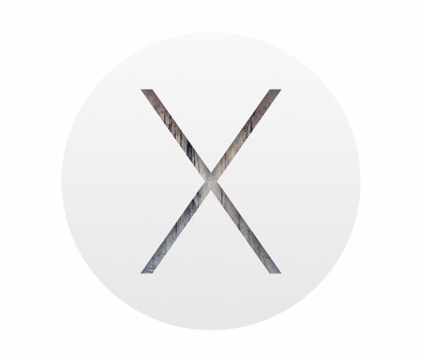

Case 4 Results cont‘d
MAC OS X:
  It gets IPv6 addresses both using SLAAC and from the DHCPv6 server.
  It also gets RDNSS both from RAs and the DHCPv6 server.
  The DNS server from DHCPv6 has higher priority.
Windows 7 and Windows 8.1:
  They get IPv6 addresses both from SLAAC and DHCPv6 server.
  They get RDNSS only from the DHCPv6 server.

Slide 29
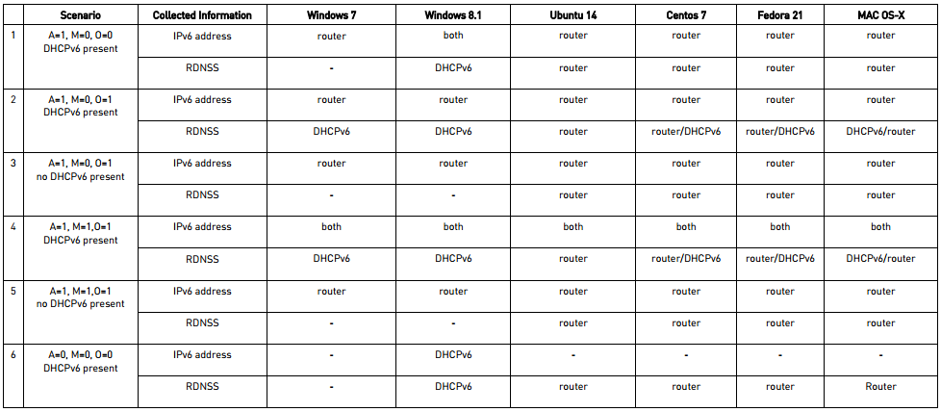
Summary
https://www.ernw.de/download/ERNW_Whitepaper_IPv6_RAs_RDNSS_DHCPv6_Conflicting_Parameters.pdf
https://tools.ietf.org/html/draft-ietf-v6ops-dhcpv6-slaac-problem-04

Slide 30

More Stuff from the Lab

Slide 31

Case 7: Router 1 Advertising M=0, O=0 and RDNSS, and then Router 2 advertising M=1, O=1 while DHCPv6 is Present
MAC OS X and Ubuntu 14.04:
  Initially they get address and RDNSS from the first router.
  When they receive RAs from the second router, they never get any information (IPv6 address or RDNSS) from the DHCPv6 server.
Initially:
One IPv6 router with the following settings:
  M=0, O=0, A=1 and RDNSS advertised and 15 seconds time interval of the RAs.
After a while (when clients are configured by the RAs of the above router) another IPv6 router with the following:
  M=1, O=1, no advertised prefix information, and 30 seconds time interval of the RAs.

Slide 32


Case 7 Results cont‘d
Fedora 21 and Centos 7:
  Initially they get IPv6 address and RDNSS from the RAs of the first router.
  When they receive an RA from router 2, they also get an IPv6 address and RDNSS from the DHCPv6 server while retaining the ones (IPv6 address and RDNSS) obtained from the RAs of the first router.
  The RDNSS obtained from the first router has a higher priority than the one obtained from the DHCPv6 server (probably because it was received first).
  When they receive again RAs from the first router, they lose/forget the information (IPv6 address and RDNSS) obtained from the DHCPv6 server.
    → Troubleshooting nightmare…

Slide 33

Case 7 Results cont‘d
Windows 7:
  Initially they get address from the first router – no RDNSS.
  When they receive RAs from the second router, they never get any information (IPv6 address or RDNSS) from the DHCPv6 server.

Slide 34

Case 7 Results cont‘d
Windows 8.1:
  Initially, they get just an IPv6 address from the first router 1 - no RDNSS information (since they do not implement RFC 6106).
  When they receive RAs from the second router, then they also get an IPv6 address from the DHCPv6 server, as well as RDNSS from it. They do not lose the IPv6 address obtained by the first router using SLAAC.
  When they receive another RA from the first router, they retain all the information obtained so far (there isn't any change).

Slide 35
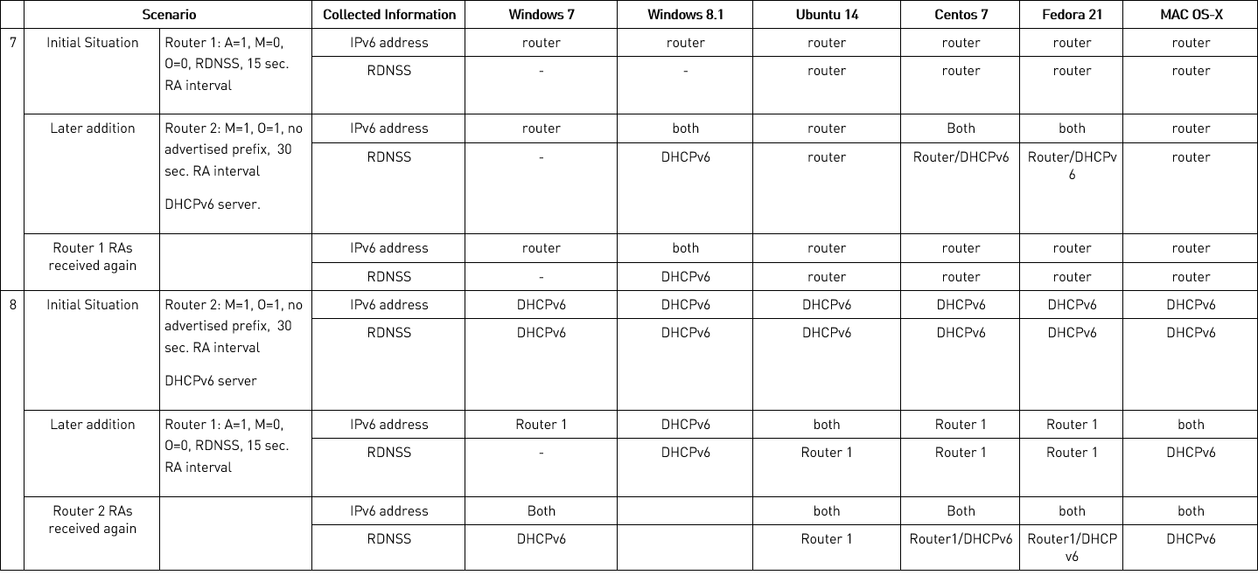
Summary

Slide 36
Conclusions

Slide 37

Don‘t assume a certain OS‘ IPv6 behavior just because:
  “the specs say so“
  “another OS does it that way“
  you have a good understanding of IPv4.
Sorry guys ;-)
Test, test, test!
  Helps to gain (even more) IPv6 knowledge anyway.
  Yes, please allocate budget for test lab.

Slide 38
Keep RFC 1925 in Mind
“(4) Some things in life can never be fully appreciated nor understood unless experienced firsthand. Some things in networking can never be fully understood by someone who neither builds commercial networking equipment nor runs an operational network.”

Slide 39
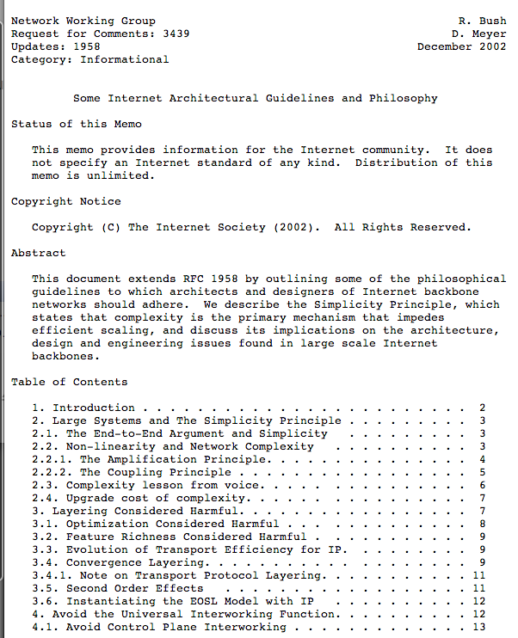
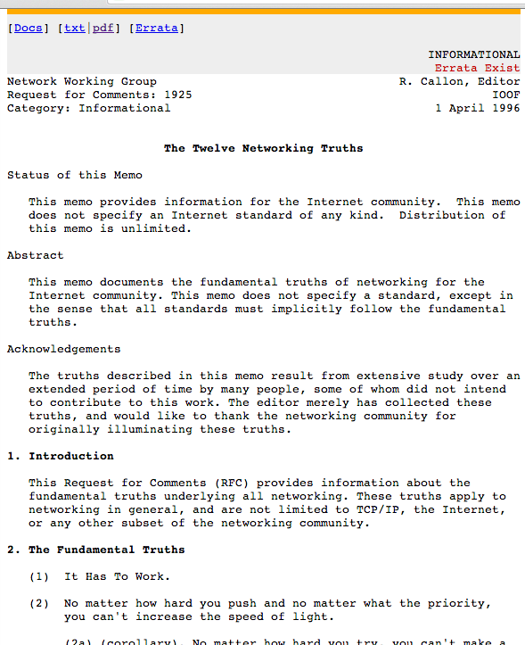
The Two Most Important RFCs Ever.
RFC 1925
The Twelve
Networking Truths
RFC 3439
Some Internet Architectural
Guidelines and Philosophy

Slide 40

Operations Perspective
Keep configs/properties related to IPv6 parameter provisioning in sync, at all times
  IPv6 transition might be an opportunity to re-think your ops model.
  Yes, we understand you‘ll be happy to survive that one mostly unscathed, hence concentrate on one task at a time. Still #justsayin ;-)

Slide 41

Planning Perspective
In short: it depends 😉
Seriously: it depends heavily on the client base you want to support. Here’s some thoughts:
  in case there’s Android devices, your routers should advertise RDNSS info (RFC 6106), else the Android clients will have to rely on their IPv4 DNS or manual kludges. RFC 6106 is supported since Lollipop.
  in case you don’t have Android devices, you might go _without_ advertising RDNSS in RAs, for the simple reason of reducing potential for errors/”unexpected behavior”.
  once you go with m-flag DHCPv6 clearing the A-flag in prefix information, but leaving the L-flag set (to “circumvent RFC 5942″) is usually a good idea.
    Ofc, you can‘t do this once there‘s Android devices as those won‘t generate any (non LL) address then.
  we observe that most of our customers strive to go with m-flag DHCPv6. that‘s just an observation...
Considerations how to set up the whole SLAAC/DHCPv6 thing

Slide 42

Troubleshooting
You should know how to diagnose a node‘s exact properties on the OS level
  incl. types of addresses and order of name resolution
    “netsh int ipv6“ commands on Win
    “ip -6 add show“ on Linux
    btw: /etc/resolv.conf not relevant on Mac
The truth is in the packets...
For the poor sod responsible...
A helpful resource:
https://wikispaces.psu.edu/display/ipv6/IPv6+Rosetta+Stone

Slide 43

Troubleshooting
Being familiar with the following certainly helps
  Flags in router advertisements
  Main DHCPv6 messages
  IPv6 Subnet Model (RFC 5942) and its (non-) relationship with DHCPv6
In such scenarios

Slide 44
Summary
Some IPv6 RFCs merely serve as an indication & inspiration how things could be implemented.
In complex & heterogeneous network you may expect surprises when it comes to the actual behavior of IPv6 nodes.
Get your hands dirty, and (re-) read RFC 3439.

Slide 45

There’s never enough time…
THANK YOU…
...for yours!

Slide 46


Save the Dates
Pre-Conference Day – Wednesday,17. June 2015
IPv6 Workshop: Build it, Use it
with Jeff Carrell
  Hands-On
IPv6 Business Conference – Thursday, 18. June 2015
Post-Conference Day – Friday, 19. June 2015
IPv6 Interactive Addressing Workshop with Practical Hands-on Labs with Jeff Carrell
  Hands-On, Build your own lab and take it home!

Slide 47






March, 14-18 2016
Heidelberg, Germany
Make the world a safer place.
Guys, we would love to see you in Heidelberg!
FOLLOW THE NEWS
@WEareTROOPERS
More Info, Extensive Archive & Registration @ www.troopers.de

Slide 48




Questions?
You can reach us at:
  erey@ernw.de, www.ernw.de
  cwerny@ernw.de, www.ernw.de
Our blog:
  www.insinuator.net
Follow me at:
  @Enno_Insinuator

