Slide 1
European IXP Topography Project
John Souter, LINX
Kurt Erik Lindqvist, Netnod

Slide 2
Background
In the peering track at NANOG62 Sylvie LaPerrière presented a comparison between population density and existence of an IXP
Authors thought we should try the same for Europe, but also try and do further analysis
  The latter turned out to be a bit harder…

Slide 3
Scope
Analyze IXP proximity to major population centres
Develop classification system for IXPs
Combine 1 & 2 into a guide for European IXP scene
Draw conclusions and try and predict future market

Slide 4
IXPs in Europe

Slide 5
IXP Classification
Membership-based IXPs
(i.e. where the members own the IXP)
Other types of not-for-profit IXPs
(e.g. those owned by trusts such as Netnod, or other industry associations, such as DE-CIX or JINX)
IXPs hosted in academic institutions or academic service organisations
(such as national academic or research networks)
IXPs operated by commercial data centre organisations
A commercially owned IXP
(such as ECIX)
Joint ventures of some combination of the above
(a fairly rare case)

Slide 6
Classification results
Mutual + Academic : 65%
Mutual + Academic + Other non-for-profit : 76%

Slide 7
Classification of the IXPs
# | IXP | City | Country | Type
1 | ALB-IX | Tirana | Albania | 5
2 | AMS-IX | Amsterdam | Netherlands | 1
3 | BCIX | Berlin | Germany | 1
4 | BIX | Budapest | Hungary | 1
5 | BIX.BG | Sofia | Bulgaria | 2
6 | BNIX | Brussels | Belgium | 3
7 | CATNIX | Barcelona | Spain | 3
8 | CIX | Zagreb | Croatia | 3
9 | CIXP | Geneva | Switzerland | 6
10 | DE-CIX | Frankfurt am Main | Germany | 2
11 | DIX | Lyngby | Denmark | 3
12 | ECIX | Berlin | Germany | 5
13 | Equinix Zurich | Zurich | Switzerland | 4
14 | FICIX | Helsinki | Finland | 1
15 | France-IX | Paris | France | 1

Slide 8
Classification of the IXPs
16 | FVG-IX | Udine | Italy | 4
17 | GigaPix | Lisbon | Portugal | 3
18 | GN-IX | Groningen | Netherlands | 3
19 | GR-IX | Athens | Greece | 3
20 | INEX | Dublin | Ireland | 1
21 | InterLAN | Bucharest | Romania | 1
22 | IXLeeds | Leeds | United Kingdom | 1
23 | LINX | London | United Kingdom | 1
24 | LONAP | London | United Kingdom | 1
25 | LU-CIX | Luxembourg | Luxembourg | 1
26 | LyonIX | Lyon | France | 1
27 | MIX-IT | Milan | Italy | 1
28 | NaMeX | Rome | Italy | 1
29 | Netnod | Stockholm | Sweden | 2
30 | NIX | Oslo | Norway | 3

Slide 9
Classification of the IXPs
31 | NIX.CZ | Prague | Czech Republic | 1
32 | NL-ix | The Hague | Netherlands | 5
33 | PLIX | Warsaw | Poland | 4
34 | RIX | Reykjavik | Iceland | 1
35 | SFINX | Paris | France | 3
36 | SIX | Ljubljana | Slovenia | 3
37 | SOX | Belgrade | Serbia | 2
38 | SwissIX | Zurich | Switzerland | 1
39 | Thinx Poland | Warsaw | Poland | 5
40 | TIX Tuscany | Florence | Italy | 2
41 | TOP-IX | Torino | Italy | 6
42 | TOUIX | Toulouse | France | 1
43 | TPIX | Warsaw | Poland | 5
44 | TREX | Tampere | Finland | 5
45 | VIX | Vienna | Austria | 3
46 | VSIX | Padova | Italy | 3

Slide 10
Major population centers
Rank | Urban Area | State | Population | IXP? | IXP names and notes
1 | Paris | France | 10 975 000 | Y | France-IX plus several more
2 | London | United Kingdom | 10 149 000 | Y | LINX, Lonap
3 | Ruhr area | Germany | 6 722 000 | Y | ECIX is in Düsseldorf (which is adjacent)
4 | Madrid | Spain | 6 183 000 | Y | ESPANIX
5 | Milan | Italy | 5 264 000 | Y | MIX
6 | Barcelona | Spain | 4 656 000 | Y | Catnix
7 | Berlin | Germany | 4 006 000 | Y | BCIX, ECIX
8 | Rome | Italy | 3 798 000 | Y | Namex
9 | Naples | Italy | 3 726 000 | N | Largest urban area in Europe with no IXP!
10 | Athens | Greece | 3 515 000 | Y | GR-IX
11 | Lisbon | Portugal | 2 669 000 | Y | GigaPix
12 | Rotterdam-The Hague | Netherlands | 2 657 000 | ? | R-IX, but not sure if it is operational
13 | Manchester | United Kingdom | 2 560 000 | Y | IXManchester
14 | Birmingham (West Midlands) | United Kingdom | 2 448 000 | N
15 | Katowice (Silesian Metropolis) | Poland | 2 231 000 | Y | TIX, Thinx, PLIX?
16 | Brussels | Belgium | 2 072 000 | Y | BNIX
17 | Hamburg | Germany | 2 057 000 | Y | DE-IX, ECIX
18 | Cologne-Bonn | Germany | 2 003 000 | N
19 | Bucharest | Romania | 1 932 000 | Y | InterLAN, Ronix
20 | Munich | Germany | 1 911 000 | Y | DEC-IX, INXS

Slide 11
Major population centers
21 | Frankfurt | Germany | 1 856 000 | Y | DEC-IX
22 | Leeds-Bradford | United Kingdom | 1 787 000 | Y | IXLeeds
23 | Vienna | Austria | 1 739 000 | Y | VIX
24 | Budapest | Hungary | 1 724 000 | Y | BIX
25 | Warsaw | Poland | 1 716 000 | Y | PLIX, TPIX, WIX, Thinx, KIX
26 | Amsterdam | Netherlands | 1 600 000 | Y | AMS-IX, NL-IX, ECIX
27 | Valencia | Spain | 1 561 000 | N
28 | Lyon | France | 1 542 000 | Y | LyonIX
29 | Turin | Italy | 1 499 000 | Y | Topix
30 | Porto | Portugal | 1 496 000 | Y | GigaPix
31 | Stockholm | Sweden | 1 456 000 | Y | Netnod
32 | Marseille | France | 1 369 000 | Y | France-IX
33 | Stuttgart | Germany | 1 354 000 | Y | Stuttgart-IX
34 | Prague | Czech Republic | 1 264 000 | Y | NIX-CZ
35 | Copenhagen | Denmark | 1 231 000 | Y | Netnod, DIX
36 | Helsinki | Finland | 1 203 000 | Y | Ficix
37 | Sofia | Bulgaria | 1 185 000 | Y | NetIX
38 | Glasgow | United Kingdom | 1 182 000 | N
39 | Dublin | Ireland | 1 158 000 | Y | INEX
40 | Seville | Spain | 1 100 000 | N

Slide 12
Major population centers
41 | Lille | France, Belgium | 1 016 000 | N
42 | Antwerp | Belgium | 990 000 | Y | NL-IX
43 | Nice | France | 962 000 | Y | NicIX (operated by Rezopole, same as LyonIX)
44 | Łódź | Poland | 939 000 | Y | Thinx
45 | Toulouse | France | 880 000 | Y | TOUIX
46 | Liverpool | United Kingdom | 864 000 | N
47 | South Hampshire | United Kingdom | 856 000 | N
48 | Bordeaux | France | 845 000 | N
49 | Thessaloniki | Greece | 840 000 | N
50 | Florence | Italy | 821 000 | Y | TIX
51 | Newcastle upon Tyne (Tyneside) | United Kingdom | 780 000 | N
52 | Gdańsk (Tricity) | Poland | 775 000 | Y | Thinx
53 | Kraków | Poland | 760 000 | Y | CIX, K-IX
54= | Bilbao | Spain | 750 000 | N
54= | Riga | Latvia | 750 000 | Y | LIX
56 | Palermo | Italy | 731 000 | N
57 | Nottingham | United Kingdom | 730 000 | N
58 | Catania | Italy | 720 000 | N
59= | Malaga | Spain | 700 000 | N
59= | Las Palmas | Spain | 700 000 | N
59= | Zaragoza | Spain | 700 000 | N
59= | Zagreb | Croatia | 700 000 | Y | CIX
59= | Dresden | Germany | 700 000 | N
59= | Hannover | Germany | 700 000 | N

Slide 13
Major regions without an IXP
The Ruhr area of Germany
Naples in Italy
Birmingham in the UK
Large cities in the biggest European countries (France, Germany, Italy, Spain and the UK)
Spanish cities (except Barcelona & Madrid)

Slide 14
Possible reasons
Telecom network topology
Market conditions
Proximity to other/existing IXPs

Slide 15
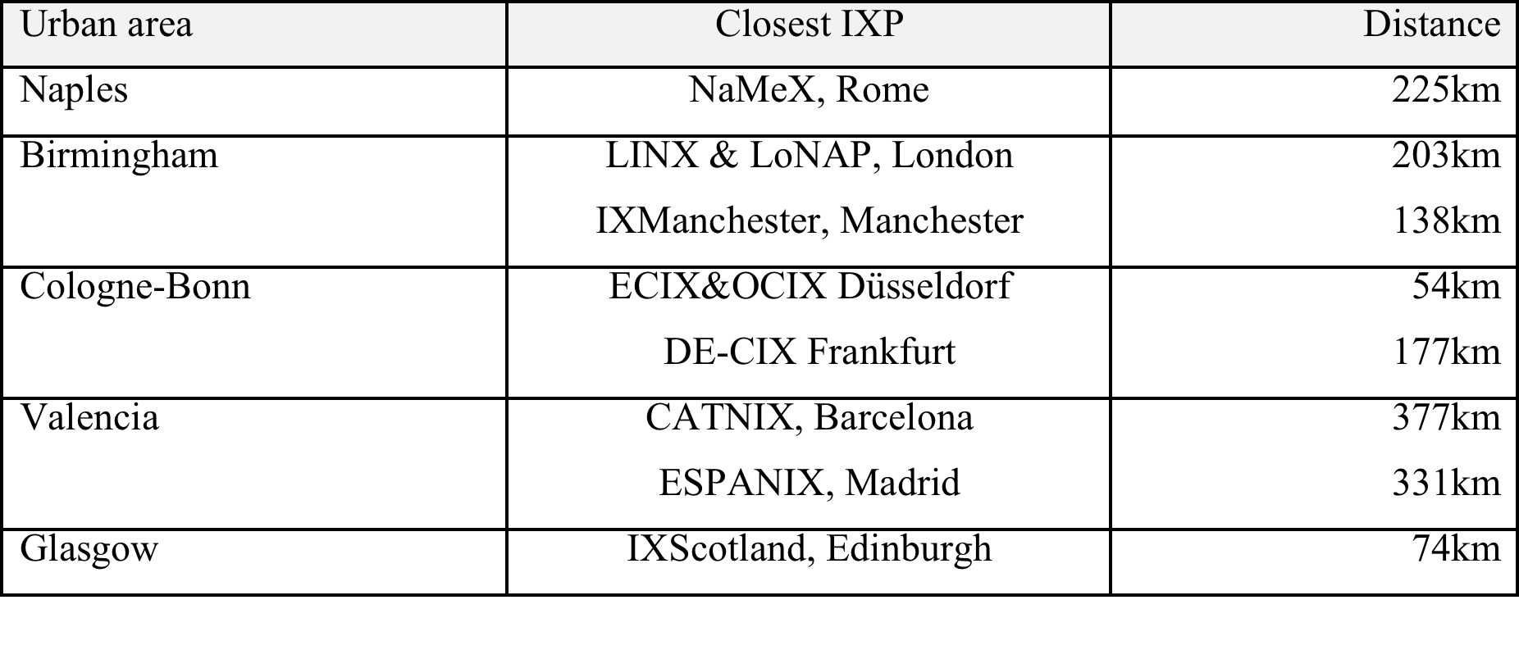
Areas Missing IXPs
Five largest urban areas missing an IXP

Slide 16
Comparison to US study
All but one of the 19 largest CSAs in the US have an IXP
  11 are major peering hubs
The smallest of the 19 would be the 11th largest in Europe
Europe seems to have a denser mesh of IXPs while lacking IXPs in more large population centers

Slide 17
Suggested developments
Investigate IXP proximity to regional GDP
  On the to-do list
Correlation to neutral datacenter availability
  Data set might be hard to acquire

Slide 18
Download Report
https://www.linx.net/archive/topography/IXP-topography-project.pdf
https://www.netnod.se/sites/default/files/IXP-topography-project.pdf

