Slide 1
Will It Be Routed?
Enno Rey, erey@ernw.de
@Enno_Insinuator

Slide 2
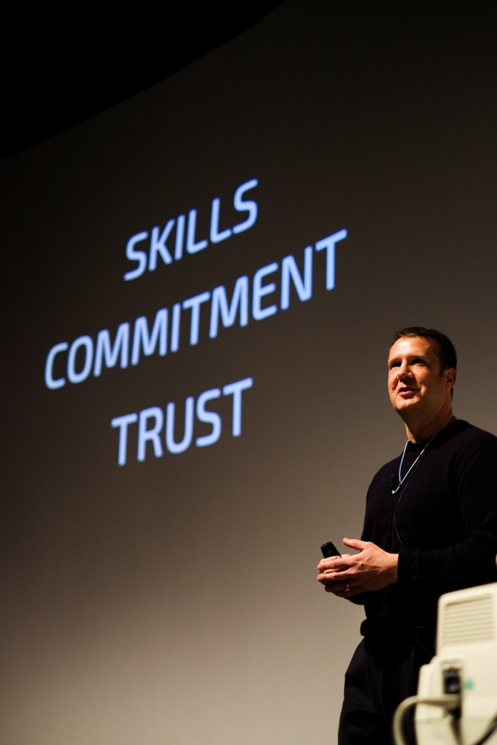
Who Am I
Old-school network guy with some background in provider operations.
Taking care of LIR administration at some enterprise LIRs
  Including the one with probably the coolest org handle: ORG-HACK1-RIPE
Involved with IPv6 since 1999 and regularly blogging about it at www.insinuator.net.

Slide 3

Agenda
Out-of-region announcements
Becoming member and applying for an allocation at various RIRs
Specifics/prerequisites/pitfalls of these procedures at the individual RIRs

Slide 4

Assumptions
Meanwhile there's two main types of LIRs
  "ISP LIRs" & "Enterprise LIRs"
In general those have very different networks and, subsequently, requirements.
I myself am mostly involved in enterprise space.
  This might have an impact on my perspective.
Plus a Disclaimer

Slide 5

Assumptions (II)
When it comes to IPv6 address space, the vast majority of (not only) large organizations decide to become a RIPE member (→ LIR), as
  This is much easier than going for PI space through a sponsoring LIR.
  It might be much cheaper as well
    Even if it wasn't the overall cost of RIR membership does not really count in $LARGE_IPv6_PROJECTs.
  Provides much more flexibility
    And you can vote at GM.
  Bad experience from the past re: address space.
Note: I don't have the impression that RIRs are particularly unhappy about this.
  Let's be honest here: having more members increases importance of any organization, right?
Actually, these are observations.

Slide 6


PI Space – Why Not!
“vielen Dank für Ihren Auftrag zur Beantragung eines /48 Provider Independent (PI) IPv6-Adressraums beim RIPE NCC. Zunächst einige Informationen zur gewünschten Beantragung.
[...]
Wir weisen ausdrücklich darauf hin, dass die internationale Konnektivität unter Umständen instabiler sein kann als die eines PA-Blocks der Deutschen Telekom.
Das hängt damit zusammen, dass nicht nur IP-Adressraum knapp ist, sondern auch die globale Routingtabelle (von der alle “border gateways“ weltweit eine Kopie halten müssen) bereits eine kritische Grösse erreicht hat. Daher gibt es Provider, die strikte prefix-length Filterung in ihrer Routing-Policy einsetzen. Als Folge hiervon kann es sein, das Ihr Netz von diesen Providern aus nicht erreichbar ist.“
“Die Gebühren für die Beantragung betragen ca. 1600 EUR“

Slide 7

Direction of this Talk
Well, this is [address-policy-wg], so one might expect a talk on prescriptive matters.
However, this talk is fully descriptive, laying out the lines of thought of some Enterprise LIRs.
  Still, understanding those might serve as input to APWG's work...
Today I have anecdotal evidence only
  In contrast to my RIPE69 [routing-wg] talk on strict prefix filtering.
https://ripe69.ripe.net/presentations/137-RIPE69_Langner_Rey_Schaetzle_Slash48_Considered_Harmful.pdf

Slide 8


Out of Region Use
Definition
What could possibly go wrong?
Position of RIRs
Real life statements & observations

Slide 9
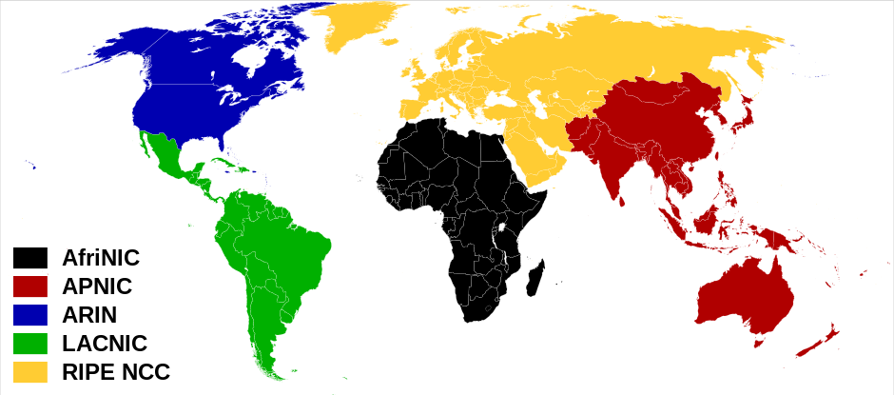
RIRs scope

Slide 10

Out of Region Use
Simply said:
Get prefix allocation from one RIR and (routing-wise) announce it,
or parts of it, in the geographic jurisdiction of another RIR.
What this is about

Slide 11

Out of Region Use
Politics / Address space poaching
  "Own" RIR doesn't have/grant address space any more, so go to another RIR & apply there, but use in own RIR's geo space.
  Only relevant for IPv4.
Technical requirements
  E.g. "local Internet breakouts"
  (together with intra-org global/GUA addressing)
Why would anybody want to do this?

Slide 12

Out of Region Use
From RIRs' perspective
  Address space poaching
From ISPs' perspective
  Cluttering routing tables with out of region announcements.
  Even worse when combined with heavy deaggregation.
From enterprise LIRs' perspective
  "Routability not guaranteed" ;-) [ripe-641, 4.2]
What could possibly go wrong?

Slide 13
Out of Region Use
Seriously: there's still operators out there doing (imho: silly) things like strict filtering. Those guys might come up with crazy ideas along the lines of
  "If we have to choose between dropping in-region /48s or out-of-region /48s, chances are we hit less customers when going with the latter..."
Concerns of Enterprise LIRs

Slide 14
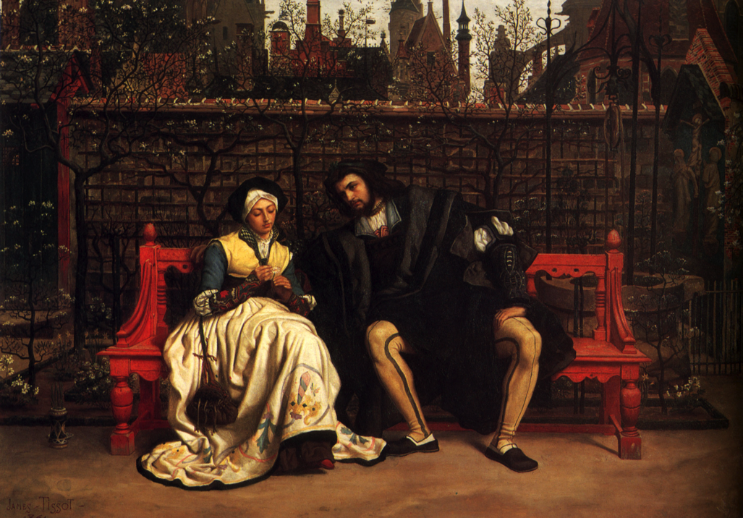
The Crucial Question:
"Will It Be Routed?“

Slide 15

As so often the Answer Is...
It depends.
OR
Who knows?

Slide 16

Guidance
What's the official position
of the RIRs?
  A: there's not too much.
What happens out there?
  A: Not much.
  Even if we had more numbers – we still don't have crystal ball.

Slide 17
Out of Region Use
ARIN
  Policy proposal ARIN-2014-1, abandoned by Advisory Council some weeks ago.
RIPE NCC
  No policy, but some statements here+there.
APNIC
  I'm not aware of anything.
LACNIC
  I'm not aware of anything.
AFRINIC
  Policy proposal heavily inspired by ARIN proposal
Position of RIRs (mainly in context of IPv4/address space poaching)

Slide 18

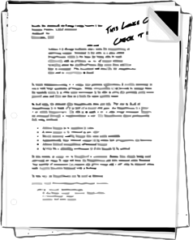
Out of Region Use
"ARIN registered resources may be used outside the ARIN service region. Out of region use of IPv4, IPv6, or ASNs are valid justification for additional number resources if the applicant is currently using at least the equivalent of a /22 of IPv4, /44 of IPv6, or 1 ASN within the ARIN service region, respectively."
https://www.arin.net/policy/proposals/2014_1.html
Main element of ARIN policy proposal

Slide 19

Out of Region Use
"RIPE NCC membership is open without conditions to everyone. However in order to receive Internet number resources the member must have a need in the RIPE NCC service region: the network that will be using the resources must have an active element located in the region.
The RIPE NCC has more than 200 member organisations which are not incorporated in the RIPE NCC services region, but do need resources for use within the region, as confirmed during their membership application process."
Andrea Cima to [arin-ppml] on 14 Apr 2015.
Main statement from RIPE's side

Slide 20

Out of Region Use
When asking some friends from ISP space, it turns out they don't see much out of region announcements, as of today.
In their guides/sessions Cisco claims to use one ARIN-assigned IPv6 prefix (2001:420::/32) only for their whole global network.
  Still this doesn't tell much about where they (AS 109) announce it.
Reality out there.

Slide 21
Out of Region Use
Some organizations might be required/tempted
to do this.
It's not yet clear if this is going to be "allowed"
by RIR policies.
  I expect it will.
It's not yet clear if it will work on a technical (routing propagation) level.
  In particular when combined with deaggregation, one might keep the "strict filtering" craziness in mind.
Most people don't like uncertainty, right?
  Which is one of the main drivers why enterprise organizations follow the route of...
Quick Interim Summary

Slide 22
Becoming Member
at Several RIRs

Slide 23
RIR Membership
Become member/LIR at one RIR (here: RIPE), plan for consistent internal addressing scheme based on one global prefix and, maybe, perform out of region announcements one day.
  "The market will solve it“
Become member/LIR at several RIRs (usually RIPE, ARIN, APNIC), plan for internal addressing scheme with multiple global prefixes and, maybe, announce "regional" more-specifics from those prefixes one day.
  Most very large organizations we know have followed this route.
  Please note that we don't really judge on this approach (either way), we just observe it happening.
Main variants from Enterprise LIR perspective and taking the above (issues|uncertainty) into account

Slide 24
Multiple RIR Approach
Some things to keep in mind

Slide 25

Disclaimer
The following four (4) slides contain some quick hints for Enterprise LIRs having decided to follow the second approach.
They are mostly irrelevant if this does not apply to you(r organization).
I will hence skip them here.

Slide 26

Membership at RIRs
Identify “suitable subsidiary in $REGION“, incl.
  Point of contact who has rough under-standing why this stuff is happening.
  Certificate of registration
  Person with signing authority
    Be prepared to explain role & function of RIRs (or what IPv6 is) to them.
Payment!
Your home work

Slide 27

Payment of RIR Fees
There‘s a one-time fee and there‘s yearly membership fees.
The invoice will be issued (but not necessarily sent) to $ORG_IN_REGION.
  Evidently so, as they are the members.
Someone has to pay it (usually within some time frame...)
  Try to centralize this, with functional mail addresses. Doing so can be very helpful in dis-cussions with $CEO_OF_REGIONAL_ORG, too.
This one deserves a dedicated slide

Slide 28

Payment of RIR Fees
Corporate Purchasing (in Budapest, Manila etc.) will contact you:
  “We don‘t have a quote from $RIR, so we can‘t act on this.“
  “$RIR has to undergo vendor screening, sign up in our supplier portal etc.“
  “What‘s that weird IPv6 or RIR stuff anyway?“
What could possibly go wrong? (I)

Slide 29
Payment of RIR Fees
If you process payment through some 3rd party (in Budapest, Manila etc.), be prepared to...
  Provide proof to $RIR that this payment relates to your application the application of $ORG_IN_REGION.
  Keep the regional guys in the (cc:) loop.
Did I already mention there‘s a limited time frame within the procedure?
Just in case you missed that: there‘s a yearly renewal fee, too ;-)
What could possibly go wrong? (II)

Slide 30

Multiple RIR Approach
APNIC
  Very easy to deal with. "Kickstart IPv6" program.
ARIN
  Easy to deal with, but some cumbersome formalities.
  Can be paid by credit card. Cool!
LACNIC
  Beware: MX und BR have own registries, so LACNIC does not "accept applications from there". Address space from those can only be used in country.
  A bit antique as for their procedures (think RIPE 10 yrs ago), but very nice, helpful people.
Some notes as for specific RIRs.
Please note that this is about IPv6 only.

Slide 31
Conclusions
We will probably see a growing amount of out of region use in the (near) future.
  For one reason or another.
Questions:
  Do you consider this a problem?
  If so, how to tackle it?
  [is APWG the right place to act on this anyway?]

Slide 32

There’s never enough time…
THANK YOU…
...for yours!

Slide 33


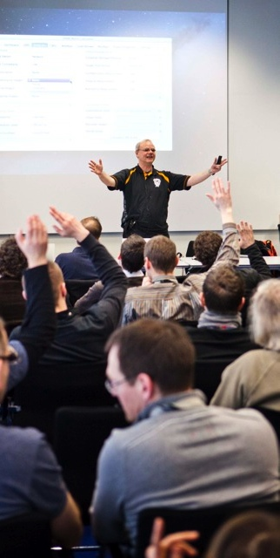
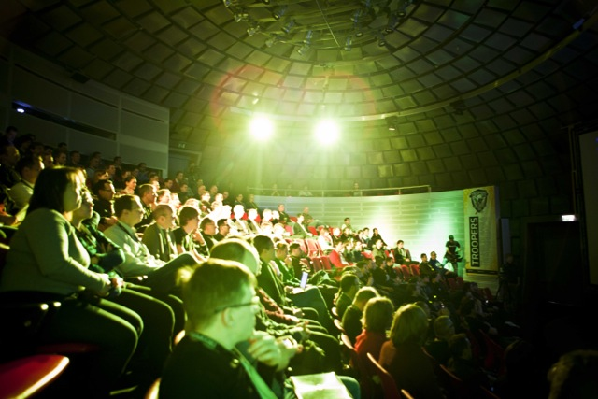
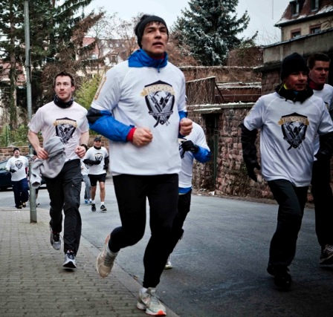

March, 14-18 2016
Heidelberg, Germany
Make the world a safer place.
Guys, we would love to see you in Heidelberg!
FOLLOW THE NEWS
@WEareTROOPERS
More Info, Extensive Archive & Registration @ www.troopers.de

Slide 34




Questions?
You can reach us at:
  erey@ernw.de, www.ernw.de
  cwerny@ernw.de, www.ernw.de
Our blog:
  www.insinuator.net
Follow me at:
  @Enno_Insinuator

