Slide 1
A framework for BGP data analysis
Alberto Dainotti, Alistair King, Chiara Orsini, Vasco Asturiano
chiara@caida.org

Slide 2
bgpstream
A software framework for the historical analysis and real-time monitoring BGP data
work in progress, soon to be released as open-source
v1 release expected for this summer
generate a sorted stream to support maintaining a BGP “state” over time
abstract from underlying data sources
filters BGP data based on user needs
tag unreliable BGP data
support real-time
Goals

Slide 3
bgpstream framework
ascii output
command-line
tool
python bindings
modular
interval-driven processing tool
bgpcorsaro
plugin1
plugin n
bgpreader
pybgpstream
bgpstream library
c library
bgpdump* library
MRT data feeds
local MRT files

Slide 4
Data Feeds
Transparent access to several annotated MRT data sources:
Previously-downloaded local files
Real-time stream from:
Colorado State’s BGPmon (all RouteViews + some extra collectors) [work-in-progress for release v1]
RIPE RIS [discussion in-progress]
Historical and continuous download from RIPE RIS and RouteViews projects
bgpdownloader
Perl program
~20 mins average delay
meta data into a bgparchive (mySQL DB)
MRT files stored on hard disk
13 active collectors
RIBS every 8 hours
Updates every 5 minutes
17 active collectors
RIBS every 2 hours
Updates every 15 minutes

Slide 5
bgpstream framework
bgpcorsaro
plugin1
plugin n
bgpreader
pybgpstream
bgpstream library
bgpdump* library
bgparchive
bgpdownloader

Slide 6
bgpstream library
access the MySQL bgparchive and select files based on
project
type
collector
time
use a modified version of bgpdump [1] to open group of dump files in parallel
extract bgprecords from these files, i.e. wrappers around the bgpdump entry format
marshal the bgprecords according to their timestamp
optionally unwrap bgprecords and extract atomic BGP information called bgpelems
[1]: https://bitbucket.org/ripencc/bgpdump/wiki/Home

Slide 7
bgprecord
Project
BGP type
Collector
Dump time
Dump position
Record time
Record status
bgpdump entry
bgparchive metadata (common to entire dump)
position of entry in dump
start
middle
end
time associated with the bgpdump entry
status of bgprecord
valid
corrupted record
empty source
corrupted source
set of MRT formatted
entries

Slide 8
bgprecord bgpelem
Project
BGP type
Collector
Dump time
Dump position
Record time
Record status
bgpdump entry
bgpelem
bgpelem
. . .
bgpdump entry
bgpelem

Slide 9
bgpelem
Announcement
State message
RIB entry
Withdrawal
Type
Timestamp
Peer IP address
Peer AS number
IP prefix
Next hop
AS path
Old state
New state
✓
✓
✓
✓
✓
✓
✓
✓
Common fields
✓
✓
✓
✓
✓
✓
✓
✓
✓
✓
✓
Type-dependent fields
✓
✓

Slide 10
bgpstream library
Updates
#include "bgpstream_lib.h”
int main(int argc, char *argv[])
{
bgpstream_t * bs = bgpstream_create();
bgpstream_record_t *rec = \
bgpstream_create_record();
bgpstream_add_filter(bs, BS_COLLECTOR, ”rrc00");
bgpstream_add_filter(bs, BS_COLLECTOR, "route-views2");
bgpstream_add_filter(bs, BS_BGP_TYPE, ”updates");
bgpstream_add_interval_filter(bs, BS_TIME_INTERVAL,
"1410285600",
"1412886500");
int init_res = bgpstream_init(bs);
while(bgpstream_get_next_record(bs, rec) > 0)
{
// [[ USE BGPRECORD HERE ]]
}
bgpstream_close(bs);
bgpstream_destroy_record(rec);
bgpstream_destroy(bs);
return 0;
}
bgpstream library
`
`
rely on metadata to decide how many dumps to open in parallel
sort based on bgprecord time

Slide 11
bgpstream framework
bgpcorsaro
plugin1
plugin n
bgpreader
pybgpstream
bgpstream library
bgpdump* library
bgparchive
bgpdownloader

Slide 12
bgpstream just a C library?
bgpreader
command line tool
bgpcorsaro
command line tool + plugins
Simplicity
pybgpstream
C Python bindings
libbgpstream
C API
Efficiency

Slide 13
bgpreader
Metadata filters
$ bgpreader -C rrc00 -C rrc03 -W1407808260,1407808440 -T updates -m
...
1407808270|195.69.145.167|6453|A|202.70.88.0/21|195.69.145.167|6453 3549 9304 23752|23752||
1407808270|218.189.6.2|9304|A|202.70.88.0/21|218.189.6.2|9304 6453 23752|23752||
1407808270|12.0.1.63|7018|A|202.70.88.0/21|12.0.1.63|7018 6453 23752|23752||
1407808270|195.69.145.167|6453|A|202.70.64.0/21|195.69.145.167|6453 23752|23752||
1407808270|193.0.0.56|3333|A|202.70.88.0/21|193.0.0.56|3333 1257 6453 23752|23752||
1407808270|195.69.144.200|12859|A|202.70.88.0/21|...
1407808270|213.200.87.254|3257|A|190.55.32.0/20|...
1407808270|213.200.87.254|3257|A|186.23.96.0/20|...
1407808270|213.200.87.254|3257|A|190.55.48.0/20|...
1407808270|213.200.87.254|3257|A|186.23.240.0/20|...
1407808270|213.200.87.254|3257|A|186.23.160.0/20|...
1407808270|213.200.87.254|3257|A|186.23.208.0/20|..
...
bgpreader
bgpstream library
bgpdump*
bgpdump compatible output
bgpreader output
bgparchive
Notes:
Tue Aug 12 01:51:00 UTC 2014 → Tue Aug 12 01:54:00 UTC 2014

Slide 14
bgpstream just a C library?
bgpreader
command line tool
bgpcorsaro
command line tool + plugins
Simplicity
pybgpstream
C Python bindings
libbgpstream
C API
Efficiency

Slide 15
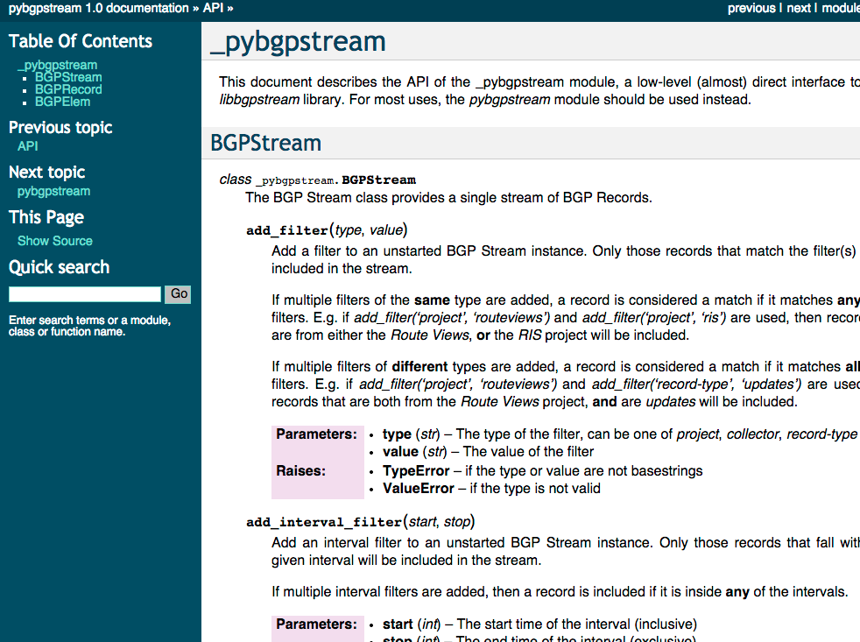
pybgpstream
Python bindings
same API exported in C
no functionalities are lost

Slide 16
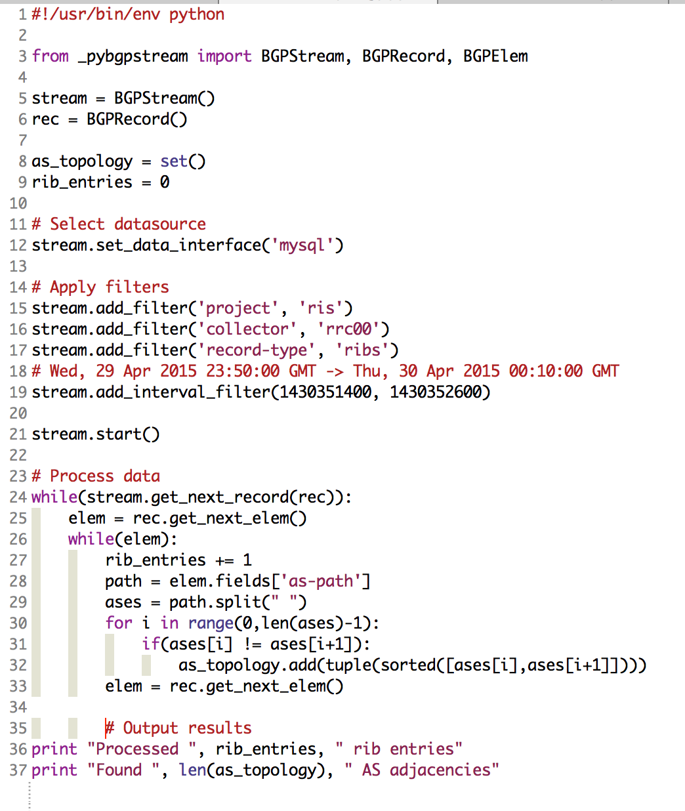
pybgpstream
What’s the AS topology seen by collector Y?
collector rrc00 on Thu, 30 Apr
1 RIB file
8,205,994 RIB entries
108,197 unique AS adjacencies
all RIS collectors on Thu, 30 Apr
13 RIB files
57,690,921RIB entries
164,739 unique AS adjacencies
2m:09s
15m:18s
#stream.add_filter(‘collector’,’rrc00’)
Notes:
All Routeviews collectors:
17 RIB files
Processed 88,751,592 rib entries
Found 159,785 AS adjacencies
In 26m

Slide 17
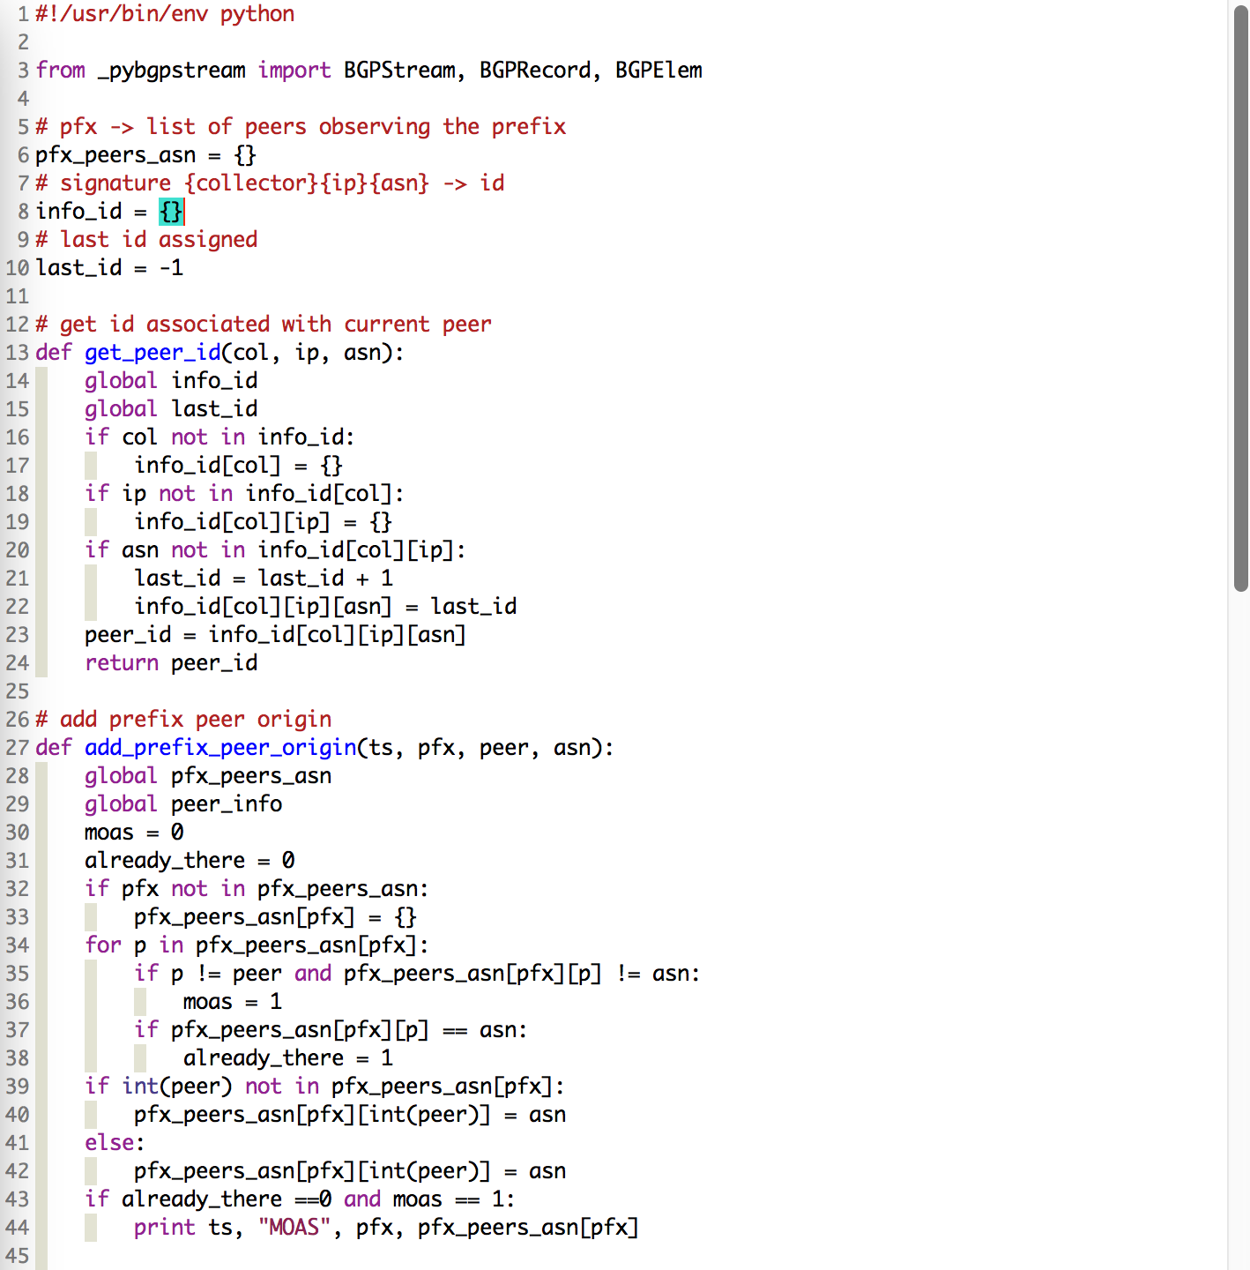
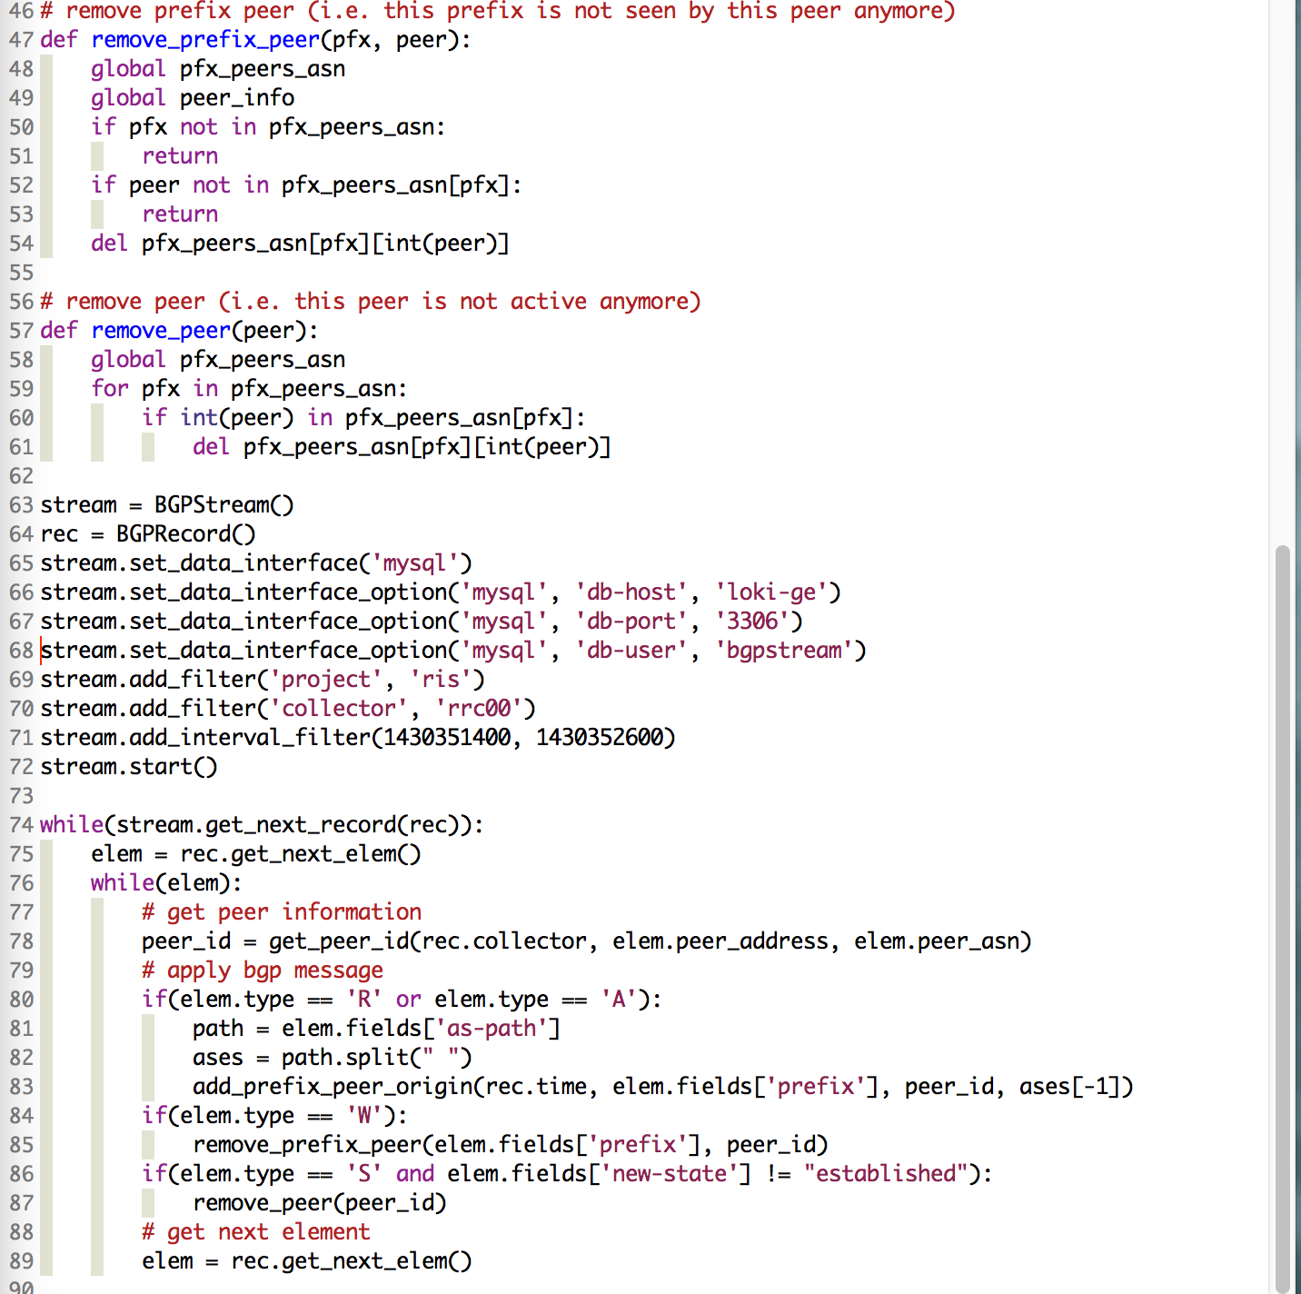
pybgpstream
What is the number of MOAS (multi origin AS) prefix events observed in a 3 hours period?
1 collector: rrc00
1 RIB file + 36 update files
3,824 MOAS events
all RIS collectors (13)
13 RIB files + 468 update files
6671 MOAS events
What if I want to do it in real time?
end time in future
just add one more line of configuration!
4m:57s
53m:16s
stream.set_blocking()

Slide 18
bgpstream just a C library?
bgpreader
command line tool
bgpcorsaro
command line tool + plugins
Simplicity
pybgpstream
C Python bindings
libbgpstream
C API
Efficiency

Slide 19
bgpcorsaro
C tool that transforms a stream of bgprecords into a set of structures and metrics representative of specific time intervals
Stream of bgprecords
Project
Collector
BGP type
Dump time
Dump position
Record time
Status
Project
Collector
BGP type
Dump time
Dump position
Record time
Status
Project
Collector
BGP type
Dump time
Dump position
Record time
Status
Project
Collector
BGP type
Dump time
Dump position
Record time
Status
Project
Collector
BGP type
Dump time
Dump position
Record time
Status
Project
Collector
BGP type
Dump time
Dump position
Record time
Status
Project
Collector
BGP type
Dump time
Dump position
Record time
Status
Project
Collector
BGP type
Dump time
Dump position
Record time
Status
Project
Collector
BGP type
Dump time
Dump position
Record time
Status
Project
Collector
BGP type
Dump time
Dump position
Record time
Status
Project
Collector
BGP type
Dump time
Dump position
Record time
Status
Project
Collector
BGP type
Dump time
Dump position
Record time
Status
Project
Collector
BGP type
Dump time
Dump position
Record time
Status
Project
Collector
BGP type
Dump time
Dump position
Record time
Status
Project
Collector
BGP type
Dump time
Dump position
Record time
Status
Project
Collector
BGP type
Dump time
Dump position
Record time
Status
Project
Collector
BGP type
Dump time
Dump position
Record time
Status
Project
Collector
BGP type
Dump time
Dump position
Record time
Status
interval driven
modular architecture based on plugins
bgpdump entry
bgpdump entry
bgpdump entry
bgpdump entry
bgpdump entry
bgpdump entry
bgpdump entry
bgpdump entry
bgpdump entry
bgpdump entry
bgpdump entry
bgpdump entry
bgpdump entry
bgpdump entry
bgpdump entry
bgpdump entry
bgpdump entry
bgpdump entry
Interval start
Interval end
Interval end
Interval start
Interval start
Interval end
PLUGIN(S)
PROCESSING
PLUGIN(S)
PROCESSING
PLUGIN(S)
PROCESSING
plugin(s) output
for interval 0
plugin(s) output
for interval 1
plugin(s) output
for interval 2

Slide 20
bgpcorsaro architecture
Interval, Plugins
Plugin Configuration
bgpstream instance
bgpcorsaro core
interval start
bgpcorsaro plugin
Project
Collector
BGP type
Dump time
Dump position
Record time
Status
Project
Collector
BGP type
Dump time
Dump position
Record time
Status
Project
Collector
BGP type
Dump time
Dump position
Record time
Status
process
Project
Collector
BGP type
Dump time
Dump position
Record time
Status
Project
Collector
BGP type
Dump time
Dump position
Record time
Status
Project
Collector
BGP type
Dump time
Dump position
Record time
Status
Project
Collector
BGP type
Dump time
Dump position
Record time
Status
Project
Collector
BGP type
Dump time
Dump position
Record time
Status
Project
Collector
BGP type
Dump time
Dump position
Record time
Status
Project
Collector
BGP type
Dump time
Dump position
Record time
Status
Project
Collector
BGP type
Dump time
Dump position
Record time
Status
Project
Collector
BGP type
Dump time
Dump position
Record time
Status
Project
Collector
BGP type
Dump time
Dump position
Record time
Status
Project
Collector
BGP type
Dump time
Dump position
Record time
Status
Project
Collector
BGP type
Dump time
Dump position
Record time
Status
Project
Collector
BGP type
Dump time
Dump position
Record time
Status
Project
Collector
BGP type
Dump time
Dump position
Record time
Status
Project
Collector
BGP type
Dump time
Dump position
Record time
Status
Project
Collector
BGP type
Dump time
Dump position
Record time
Status
plugin output
bgpdump entry
bgpdump entry
bgpdump entry
bgpdump entry
bgpdump entry
bgpdump entry
bgpdump entry
bgpdump entry
bgpdump entry
bgpdump entry
bgpdump entry
bgpdump entry
bgpdump entry
bgpdump entry
bgpdump entry
bgpdump entry
bgpdump entry
bgpdump entry
bgpdump entry
interval end
bgprecords stream
interval signals
program output

Slide 21
bgpcorsaro plugins
routingtables plugin:
it maintains the state and the routing table of each peer
BGP finite state machine per peer
RIBs and updates
recover from out of order and corrupted data
outputs statistics every minute (of BGP time)
Notes:
Overall, we have to maintain 574 ipv4 routing tables and 301 ipv6 routing tables ~ 900 routing tables using a single process ~ 15GB of RAM (3 times slower than real time)

Slide 22
bgpcorsaro routingtables plugin
RouteViews2 – 3549 – Los Angeles
RRC00 – 3549 – Palo Alto
RouteViews2 – 3549 – Palo Alto
https://charthouse.caida.org/@Ee

Slide 23
bgpcorsaro routingtables plugin
Announcements
Withdrawals
https://charthouse.caida.org/@zs

Slide 24
bgpcorsaro routingtables plugin
Unique prefixes appearing in announcements
Unique prefixes appearing in withdrawals
https://charthouse.caida.org/@fg

Slide 25
bgpstream framework
per-region visibility
per-as visibility
bgpwatcher
bgpreader
pybgpstream
bgpcorsaro
plugin
routingtables
plugin
bgpstream library
bgpdump*
bgparchive
bgpdownloader
Notes:
30 active collectors: 875 peers (from 590 unique ASes)

Slide 26
questions ?
thanks
Chiara Orsini chiara@caida.org

Slide 27
CAIDA framework for real-time outage detection
per-region visibility
per-as visibility
bgpwatcher
bgpreader
pybgpstream
bgpcorsaro
routingtables
bgpstream library
bgpdump*
bgparchive
bgpdownloader
https://www.caida.org/funding/ioda
Notes:
30 active collectors: 875 peers (from 590 unique ASes)

Slide 28
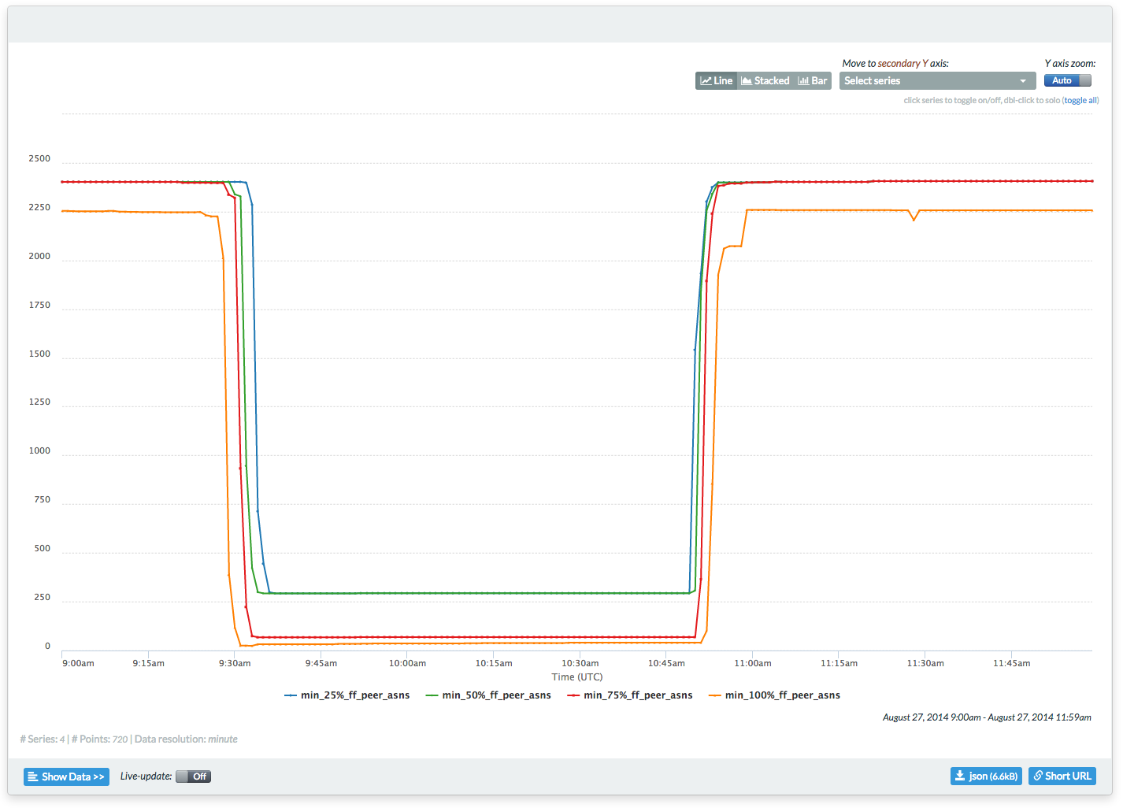
Time Warner Cable outage
prefixes originated by 15 TWC ASes
177 full feed unique peer ASes
https://charthouse.caida.org/@wb
Notes:
August 27th, 2014
IPv6 is not affected

Slide 29
backup slides

Slide 30
Data sources (May 2015)
 | Collectors | IPv4 | IPv6 | Total
RIS | 13 | 343 | 158 | 501
RouteViews | 17 | 231 | 143 | 374
Total | 30 | 574 | 301 | 875

Slide 31
bgpdownloader
A Perl tool that downloads BGP dump files from:
These websites provide data in the form of compressed MRT [RFC 6396] files
Each file (or dump) contains routing information related to all the peers connected to the collector
13 active collectors
RIBS every 8 hours
Updates every 5 minutes
17 active collectors
RIBS every 2 hours
Updates every 15 minutes
https://www.ripe.net/data-tools/stats/ris
http://www.routeviews.org/

Slide 32
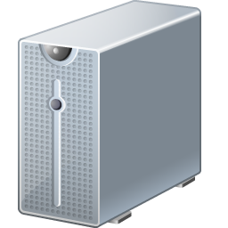
bgpdownloader
peer
collector
New!
peer
1
collector window starts
2
collector window stops
3
update file is published
5 (15) min
new file is observed
4
new file is downloaded
5
new file is available in db
6
bgparchive
Collector | BGP type | File_time | File size | Timestamp
rrc00 | updates | 2014-12-10 00:45:00 UTC | 513K | 2014-12-10 00:51:22 UTC

Slide 33
bgpdownloader take away messages
Each collector presents a characteristic delay
RIS and Routeviews have different behaviors
RIBs and updates delays are different
The total delay of RIS updates has some recurring behavior
On average we expect to process BGP routing information after
 | RIBs | Updates
RIS | 11.5 min | 7.5 min
Routeviews | 6.5 min | 16.8 min

Slide 34
15 mins
5 mins
https://charthouse-dev.caida.org/@ru

Slide 35
https://charthouse-dev.caida.org/@rv

Slide 36
5 mins
https://charthouse-dev.caida.org/@Jh

Slide 37
bgpdump modified
instance safe
added support for corrupted records signaling
added wandio read option
bugfixes:
solved conflict with mySQL library (same name function)
fixed bug in AS path management

Slide 38
Hello bgpstream World!
#include "bgpstream_lib.h”
int main(int argc, char *argv[])
{
bgpstream_t * bs = bgpstream_create();
bgpstream_record_t *rec = bgpstream_create_record();
int init_res = bgpstream_init(bs);
while(bgpstream_get_next_record(bs, rec) > 0)
{
// [[ USE BGPRECORD HERE ]]
}
bgpstream_close(bs);
bgpstream_destroy_record(rec);
bgpstream_destroy(bs);
return 0;
}
Allocate memory
Start interface
Pull bgprecords
Stop interface
Deallocate memory

Slide 39
bgpstream filters
...
bgpstream_t * bs = bgpstream_create();
bgpstream_add_filter(bs, BS_PROJECT, "routeviews");
bgpstream_add_filter(bs, BS_COLLECTOR, "route-views2");
bgpstream_add_filter(bs, BS_COLLECTOR, "route-views.linx");
bgpstream_add_filter(bs, BS_BGP_TYPE, ”updates");
bgpstream_add_interval_filter(bs, BS_TIME_INTERVAL,
"1410285571",
"1412877600");
int init_res = bgpstream_init(bs);
...
Tue, 09 Sep 2014 17:59:31 GMT
Thu, 11 Sep 2014 00:32:51 GMT

Slide 40
bgpstream extract bgpelems
...
while(bgpstream_get_next_record(bs, rec) > 0)
{
if(rec->status == VALID_RECORD)
{
bs_elem = bgpstream_get_elem_queue(rec);
while(bs_elem)
{
// [[ USE BGPELEM HERE ]]
bs_elem = bs_elem->next;
}
}
}
...

Slide 41
bgpcorsaro how to write a plugin?
# lib/bgpcorsaro_plugin.h
typedef enum bgpcorsaro_plugin_id
{
/** Other plugin */
BGPCORSARO_PLUGIN_ID_OTHER = 1,
/** My New Plugin */
BGPCORSARO_PLUGIN_ID_MYPLUGIN = 2,
...
/** Maximum plugin ID assigned */
BGPCORSARO_PLUGIN_ID_MAX = 2
} bgpcorsaro_plugin_id_t;
Provide a new plugin ID
to the plugin manager

Slide 42
bgpcorsaro how to write a plugin?
# lib/plugins/bgpcorsaro_myplugin.c
bgpcorsaro_plugin_t *
bgpcorsaro_myplugin_alloc(bgpcorsaro_t *bgpcorsaro)
int
bgpcorsaro_myplugin_init_output(bgpcorsaro_t *bgpcorsaro)
int
bgpcorsaro_myplugin_close_output(bgpcorsaro_t *bgpcorsaro)
Create the plugin
Allocate memory for the plugin
Deallocate memory for the plugin

Slide 43
bgpcorsaro how to write a plugin?
# lib/plugins/bgpcorsaro_myplugin.c
int
bgpcorsaro_myplugin_start_interval(bgpcorsaro_t *bgpcorsaro,
bgpcorsaro_interval_t *int_start)
int
bgpcorsaro_myplugin_process_record(bgpcorsaro_t *bgpcorsaro,
bgpcorsaro_record_t *record)
int
bgpcorsaro_myplugin_end_interval(bgpcorsaro_t *bgpcorsaro,
bgpcorsaro_interval_t *int_end)
process START of interval signal
process record
process END of interval signal

Slide 44
CAIDA framework for real-time outage detection
Real-time challenges:
collectors delay varies a lot:
project constraints
per collector differences
the computational load of each collector varies too
Processing challenges
we need to process BGP data faster than real time in order to keep up with the flow

Slide 45
CAIDA framework for real-time outage detection
per-region visibility
per-as visibility
we need to process BGP data faster than real time in order to keep up with the flow!
collectors delay varies a lot:
project constraints
per collector differences
the computational load of each collector varies too
1 bgpcorsaro per collector
a bgpwatcher server that:
collects all the routing tables
distributes the aggregated views to consumers
bgpwatcher
bgpcorsaro
routingtables
bgpstream library
bgpdump*
bgparchive
bgpdownloader
https://www.caida.org/funding/ioda
Notes:
30 active collectors: 875 peers (from 590 unique ASes)

Slide 46
CAIDA framework for real-time outage detection
bgpcorsaro plugins
producer clients*
bgpwatcher
server
bgpwatcher
consumers
bgpcorsaro plugin
per-as visibility
bgpstore
bgpview
bgpview
bgpview
…
bgpcorsaro plugin
TS1
TS2
TS..
routingtables
bgpviews

Slide 47
CAIDA framework for real-time outage detection
per-region visibility
per-as visibility
bgpwatcher
bgpcorsaro
routingtables
bgpstream library
bgpdump*
bgparchive
bgpdownloader
https://www.caida.org/funding/ioda
Notes:
30 active collectors: 875 peers (from 590 unique ASes)

Slide 48
Time Warner Cable outage
all prefixes geo-located in US
177 full feed unique ASes
https://charthouse.caida.org/@UT

