Slide 1
RIPE 70 BCOP Task Force
Monday, 11th May 2015

Slide 2
Agenda
Administrative Matters and Agenda Bashing [5 min] – Benno and Jan
Update: RIPE-631 BCOP Published [5 min] – Jan Žorž
Update from NANOG BCOP [5 min] – Chris Grundemann
DNS TTL Values for the Modern World [20 min] – Olafur Gudmundsson
Network Operations Simplicity BCOP [20 min] – Gunter Van de Velde, Berislav Todorovic, Hans Thienpondt
A Guide About DDoS Attacks [10 min] – Guillaume Valadon
Open Microphone Session: Ideas for New BCOPs and Volunteering [0 min]

Slide 3
About BCOP TF – a refresh
Mailing list: https://www.ripe.net/mailman/listinfo/bcop
Charter: https://www.ripe.net/participate/ripe/tf/bcop

Slide 4
What are we doing here?
The Best Current Operational Practices Task Force aims to:
Identify and discuss operational issues among the operators and to produce document series that capture the best practices for operationalising Internet technologies.
Provide a way to make good operational practices reference documents easily available, e.g., via RIPE Documents series.
Documents should be produced by experienced operators.
Provide a place for operators to identify, discuss, and communicate their operational needs, and if there are no standards for this problem, channel these to the standards process.

Slide 5
Update from last meeting
“Troubleshooting IPv6 for Residential ISP helpdesks” document draft was on 23rd Feb 2015 published as RIPE-631 !
https://www.ripe.net/publications/docs/ripe-631
Congratulations, we’ve got a first RIPE BCOP document out there ☺

Slide 6
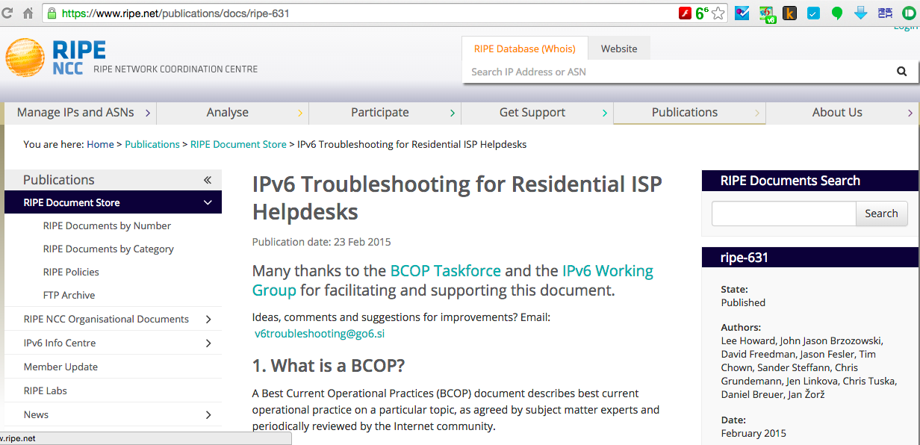
RIPE-631

Slide 7
Other BCOP efforts around the world?
Let’s hear from Chris Grundemann what’s going on at NANOG BCOP
Any other representatives from any other BCOP activity in other regions in the room and would like to do a quick update?

