Slide 1
APNIC Update
15 May 2015
Paul Wilson
15 Apr 2015

Slide 2
APNIC’s Vision
A global, open, stable, and secure Internet that serves the entire Asia Pacific community

Slide 3
APNIC in 2014
Serving
Supporting
Collaborating

Slide 4
IPv6 Delegations
By delegation type
By size
By request type
As at 30 April

Slide 5
IPv4 Delegations
By pool
By size
By Member
As at 30 April

Slide 6
IPv4 Transfers
Using listing service
Pre-approval usage
As at 30 April

Slide 7
ASN Assignments
By type
4-byte return rate
Global ASN use
As at 30 April

Slide 8
APNIC Membership
As at 31 December

Slide 9
Total NIR Sub-Accounts
As at 31 December

Slide 10
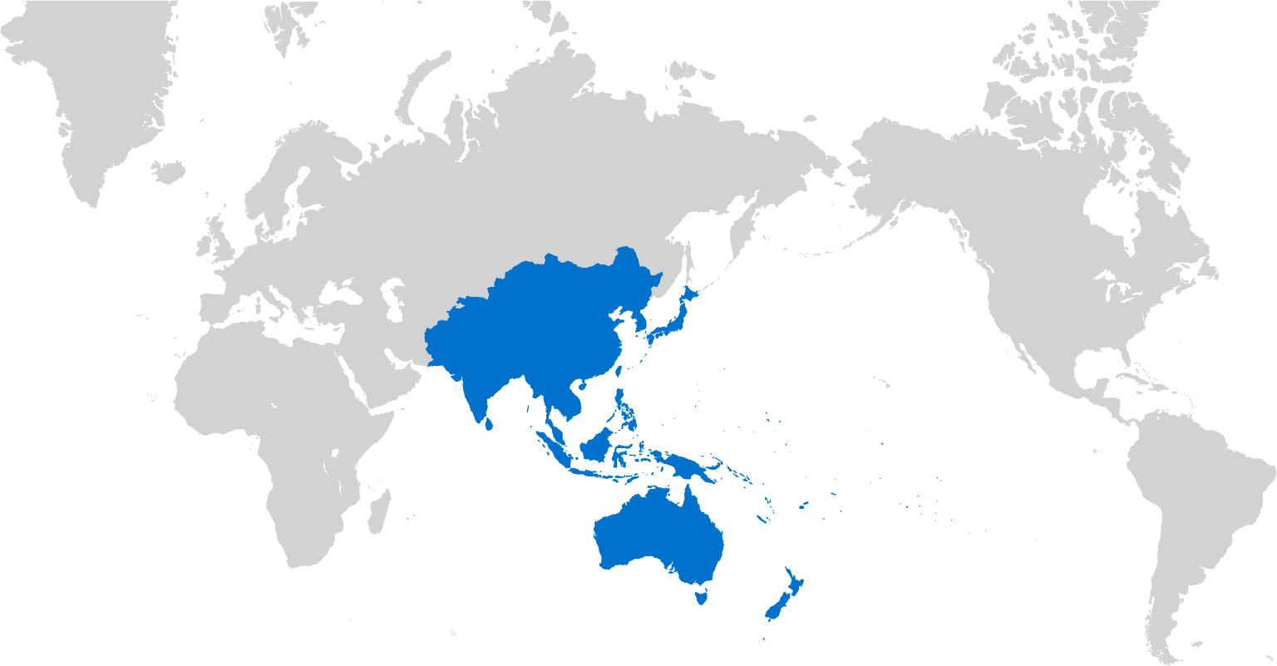
Distributed Whois
Deployed distributed Whois service to improve responsiveness and resilience
4 servers now operating:
Brisbane, Tokyo, London, Fremont
Response times have improved up to 10x for majority of users
Multiple sites to sink attack traffic without bringing the service down

Slide 11
Distributed Whois

Slide 12
Distributed Whois

Slide 13
Improved System Architecture
Based on Message Bus
integration pattern
MyAPNIC
WHOIS
RPKI
Deployment on Linux (CentOS) Java 7 development environment
Apache ActiveMQ inter-process communications
Apache ActiveMQ
Increased responsiveness provides improved user experience
Faster development cycles for new feature requests

Slide 14
Supporting Infrastructure
VMware virtualization
for increased reliability
(175+ machines)
Deployment of Puppet Configuration Management
for centralized synchronization and updates
DRP audit and exercising

Slide 15
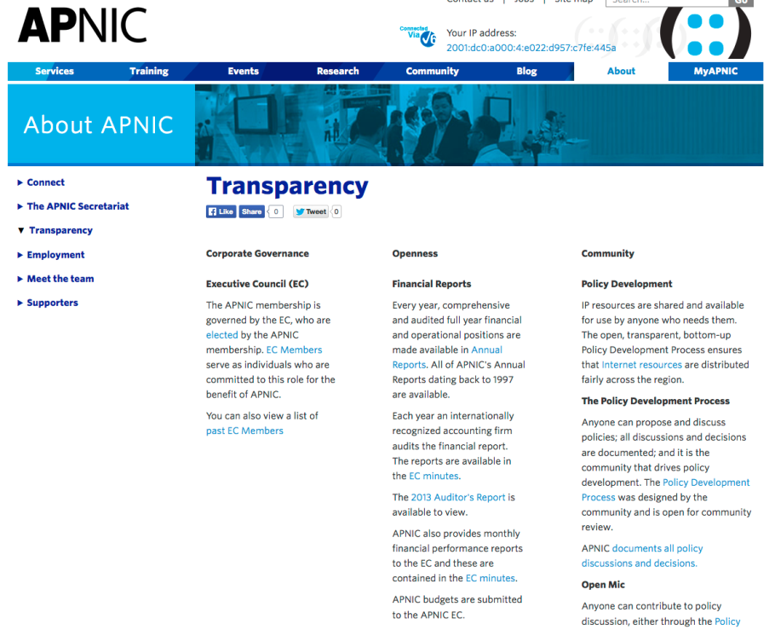
Accountability & Transparency
Transparency web page updated
RIR accountability matrix
Improved internal financial audit process established
Appointment of new external financial auditors
ISO9001 external audit – passed!

Slide 16
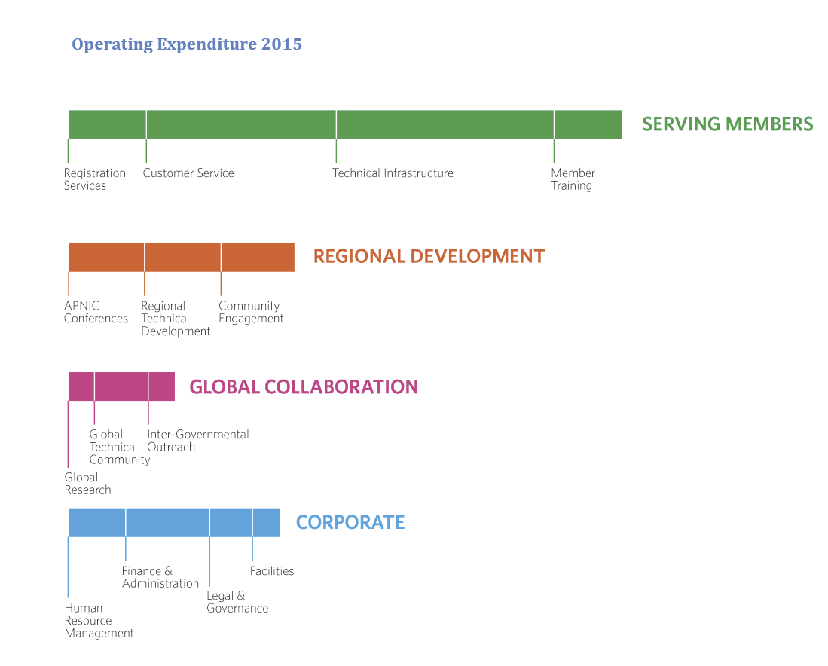
2015 Activity Plan & Budget
Clearer account of planned activities and resource allocation

Slide 17
APNIC in 2014
Serving
Supporting
Collaborating

Slide 18
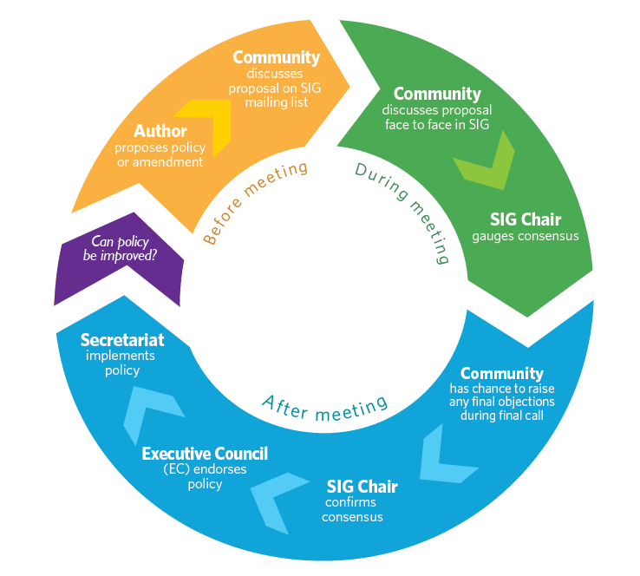
Policy Development
PDP central to APNIC activities
Gauging consensus is critical

Slide 19
2014 Policy Implementations
prop-107: AS number transfer proposal
16 April
prop-109: Allocate 1.0.0.0/24 and 1.1.1.0/24 to APNIC Labs as Research Prefixes
7 May
prop-105: Distribution of returned IPv4 address blocks (Modification of prop-088)
27 May

Slide 20
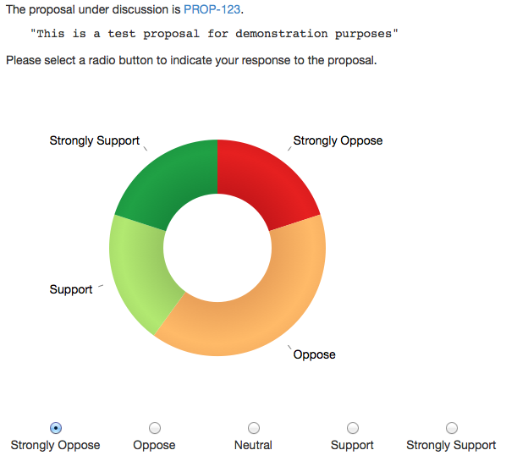
CONFER: Consensus Tool
Captures participants’ views in real time
Piloted at APNIC 38
Supporting tool for future SIGs

Slide 21
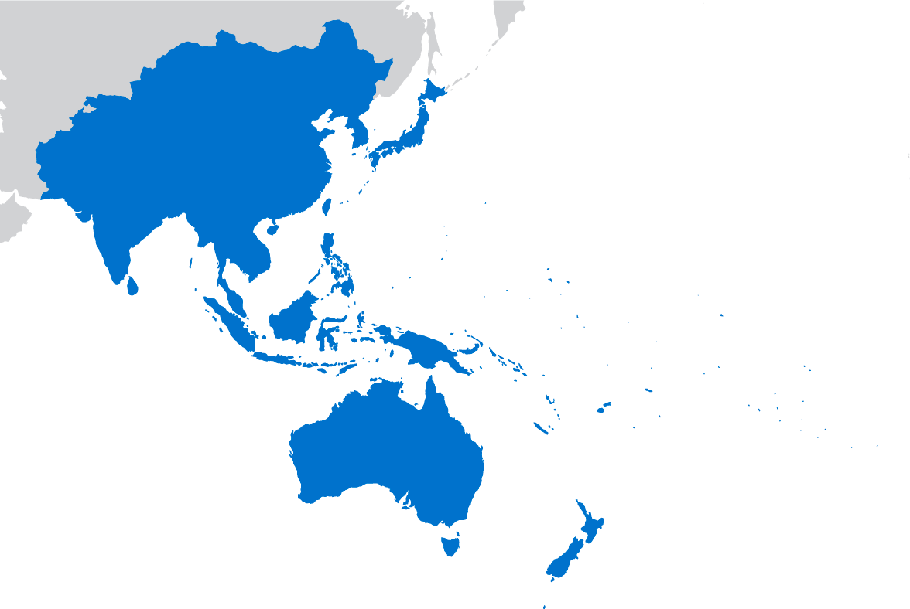
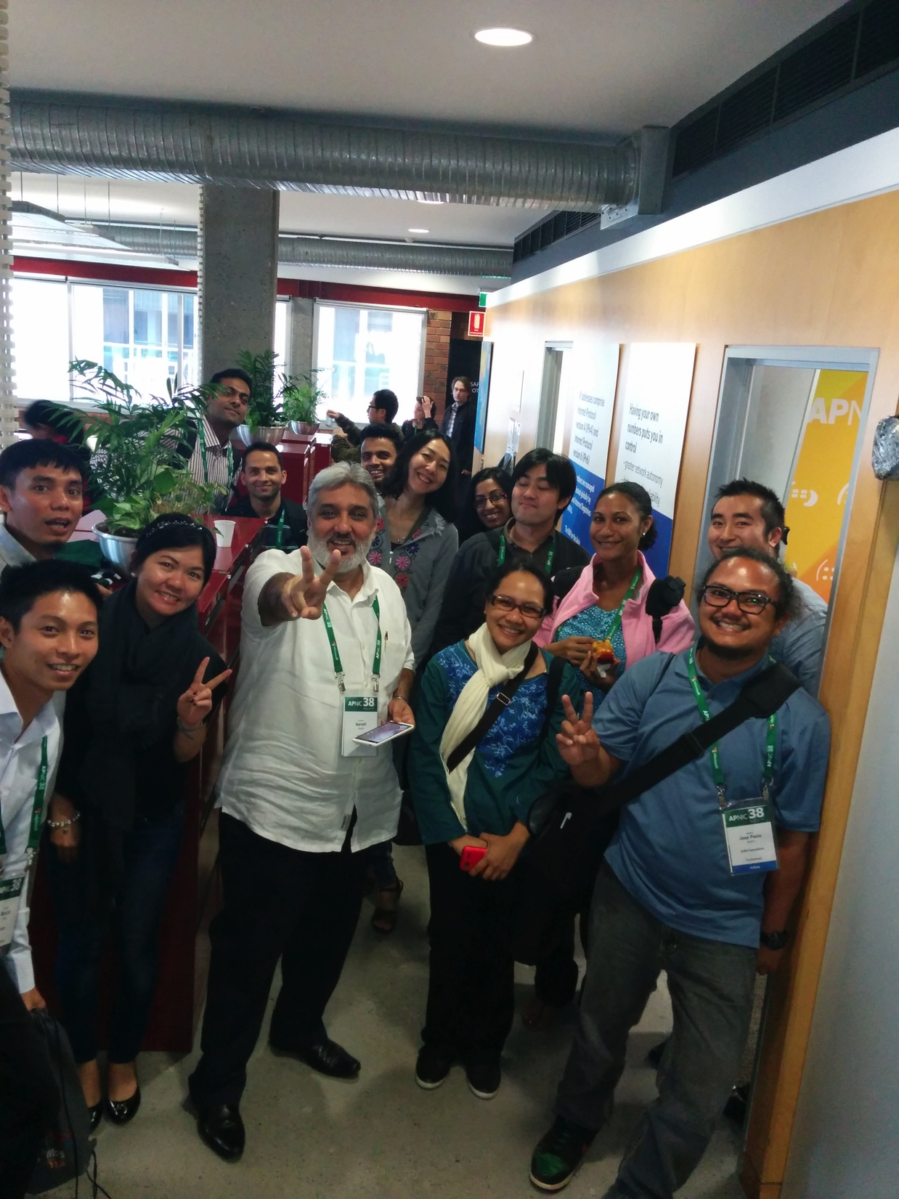
APNIC Events 2014
Mix of small and large regional meetings to effectively reach Members
Improved video and social media coverage
Expanded community meetings at APNIC 38: APTLD, Pacific Workshop, ISOC
Member visits to Brisbane office as part of APNIC 38 experience
‘Meet the EC’ social event introduced
ARM 3
ARM 5
ARM 2
ARM 4
APRICOT 2014
ARM 6
APNIC 38

Slide 22
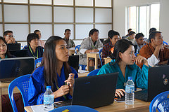
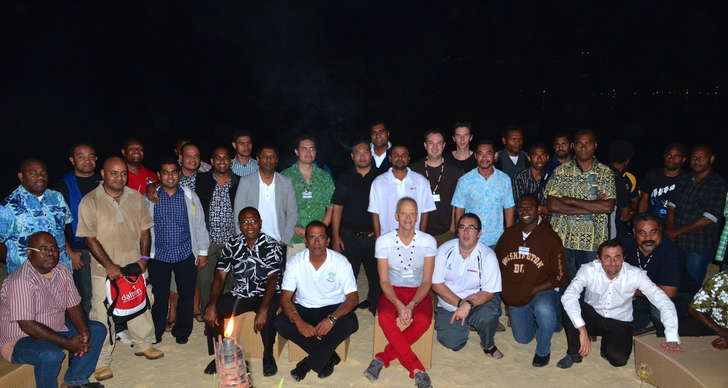
Training
76 face-to-face courses held in 29 locations
2,352 professionals trained face-to-face
534 professionals trained via 141 eLearning sessions
Video archives
63 videos
177,993 views

Slide 23
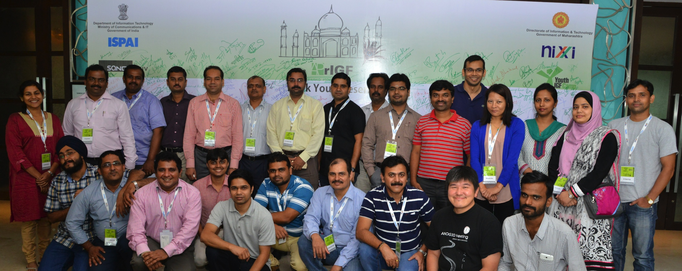
NOGs
Expert training to build skills
Knowledge sharing on IPv6, network security, transfers
APNIC Hostmaster support to answer Member queries
Financial/logistical support where needed
BTNOG 1
SANOG 24

Slide 24
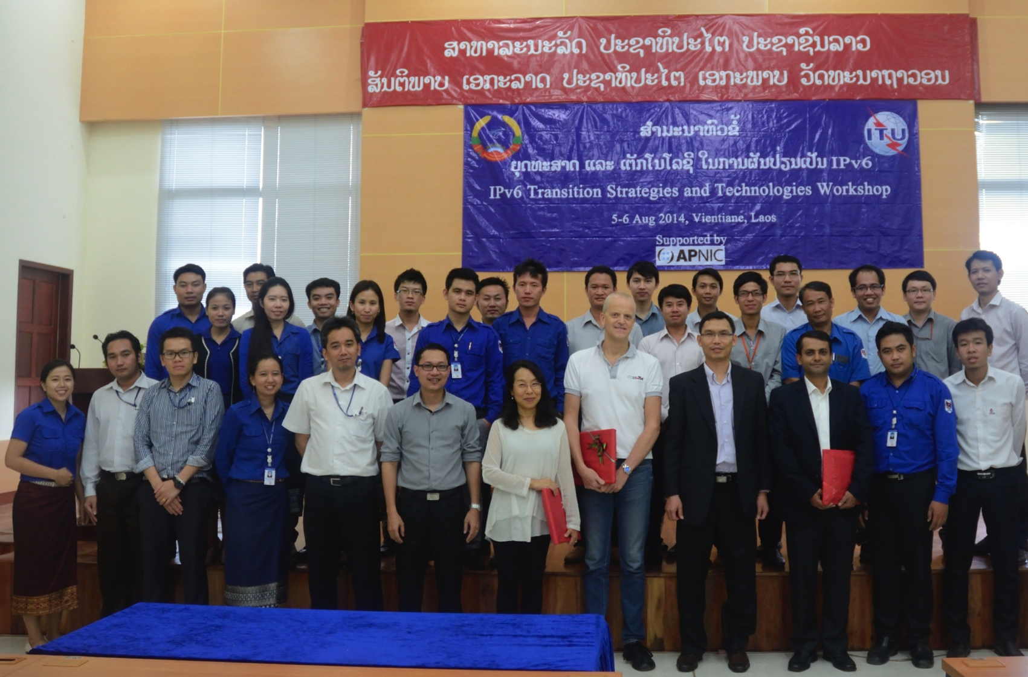
IPv6
686 professionals trained in 16 economies
Presented at 24 industry events
Generated 26 pieces of IPv6 media coverage
Joint IPv6 workshops with ITU
Continuous support to APIPv6TF
ITU/APNIC IPv6 Workshop. Lao

Slide 25
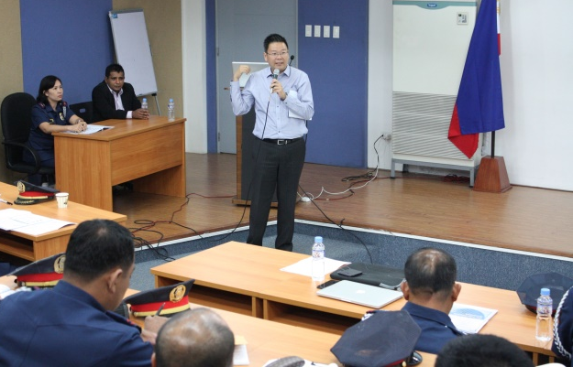
Security Outreach
Adli Wahid
Craig Ng
Participation in NOGs, CSIRTS and LEA events to educate and learn
Training for Pacific LEAs held in NZ, Brunei and Indonesia
Promoting new initiatives & security best practices among Members

Slide 26
RPKI
10 face-to-face and elearning RPKI training courses delivered
RPKI presentations to NOGs and conferences
Development of the ‘Ready to ROA’ Campaign – hands on sessions to help Members create ROAs
New shirts, stickers, web content to promote campaign
Ready to ROA launched in 2015

Slide 27
APNIC in 2014
Serving
Supporting
Collaborating

Slide 28
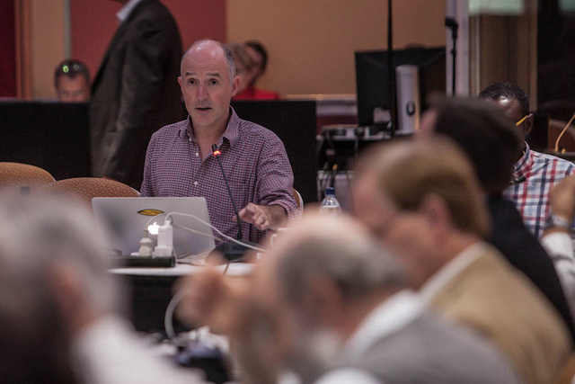
Global Cooperation
IPv6 advocacy
Coordination with RIRs and Internet organizations
Engaging with government agencies in training and skills development
Supporting IANA Stewardship Transition
Promoting the RIR model

Slide 29
Engagement map 2014
Training
NOGs
Events
IPv6
Security
Cooperation

Slide 30
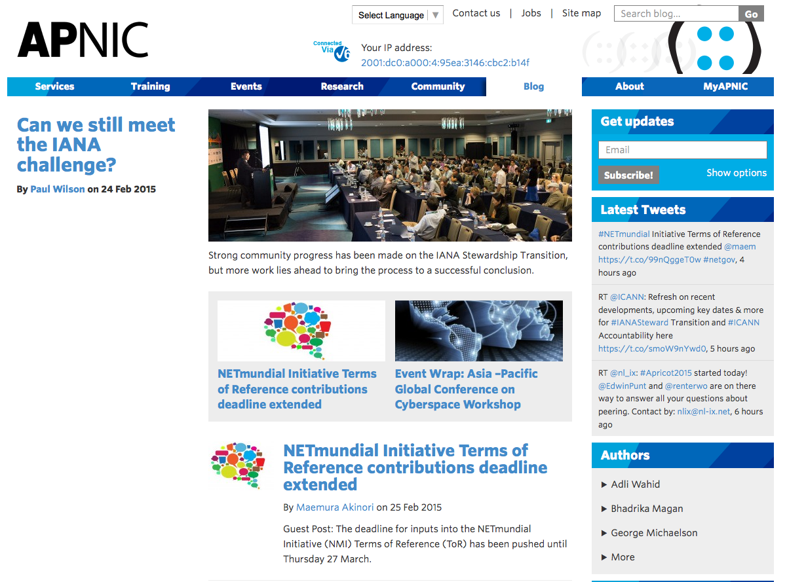
blog.apnic.net
APNIC Blog launched in August 2014 to simplify APNIC communication
Simple and more engaging format
Total of 232 Posts
33 bloggers – including 12 guest community bloggers
39,000+ views – ave 239/day

Slide 31
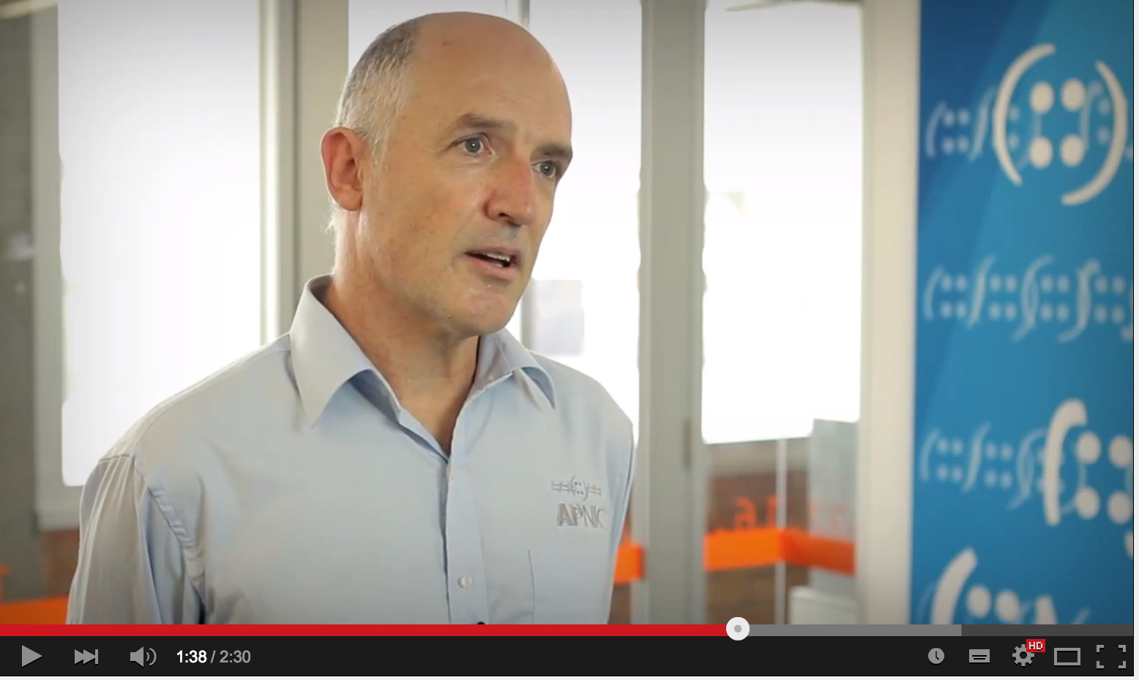
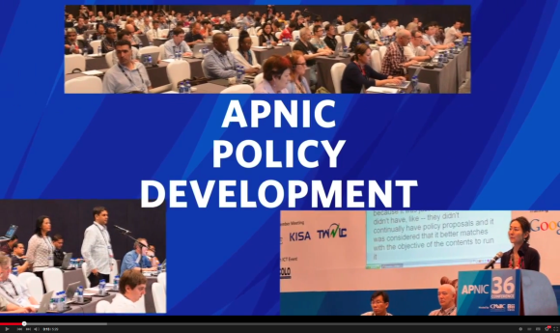
Improving Communication
‘Event wraps’ for clear reporting of APNIC event activities
More active social media
Twitter: 1,182 new followers (￪ 45%)
Facebook: 163,438 people reached organically (￪ 126%)
Weibo: established 2014
Updated APNIC video library
YouTube: 10,605 views (￪ 84%)
Website refresh – more to come!

Slide 32
You’re Invited!
APNIC 40, Jakarta, Indonesia 3-10 September 2015
conference.apnic.net/40

Slide 33
Thank you
pwilson@apnic.net

