Slide 1
The Role of Analytics in Routing, Network Performance and SDN Cengiz Alaettinoglu

Slide 2
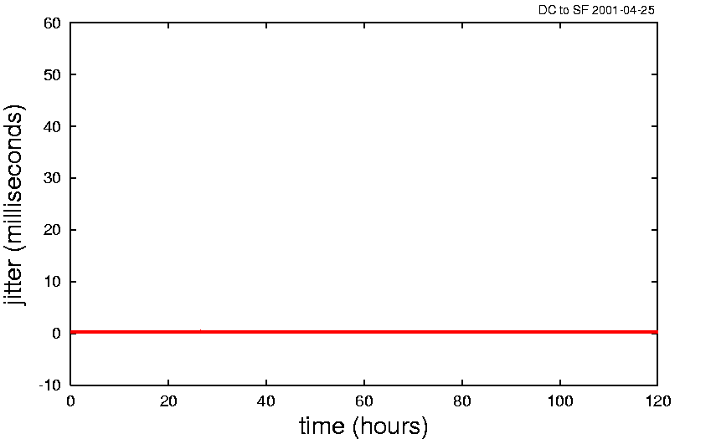
It all started with a jitter study (2000)
Studied jitter on 3 US and 1 European backbones for several weeks
For 99.99% packets, measured jitter < 1ms

Slide 3
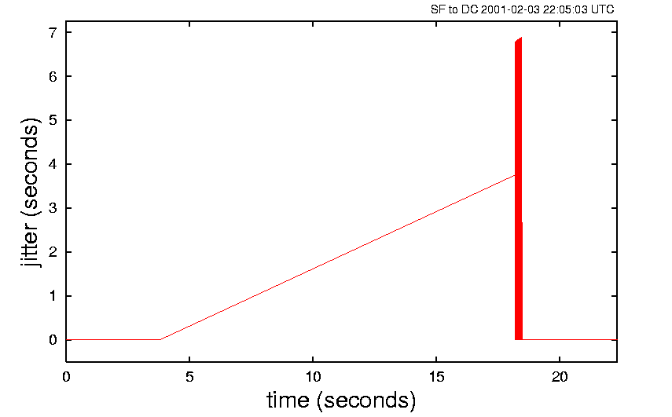
However, 0.01% of Jitter was severe
7 seconds jitter
10+ seconds packet drops
Severe packet reordering

Slide 4
Theory: Packets being spewed out from an unwinding routing loop…
Did we really have long routing loops in the network?
Did ISIS really take 10+ seconds to converge?
So, we analyzed routing along with jitter
Test Host
Test Host
traffic
sk
gig-ether
IP Backbone
ISIS
hellos +
tcpdump
R
R
traceroute
every 5s
Test host is
passive peer,
sends no routes
packet
trace
file

Slide 5
ISIS in a Nutshell
Each router sends Link State Packets (LSP) that describes its local topology
List of links to neighbors (adjacencies), prefixes along with metrics
This is refreshes periodically, otherwise LSP content is purged
This is flooded across the network
Each router send new LSPs it receives to its neighbors
Neighbors sends to their neighbors, …
Each router accumulates LSPs into a database (LSDB) and constructs the current view of the topology
Shortest paths are computed using Dijkstra's SPF algorithm

Slide 6
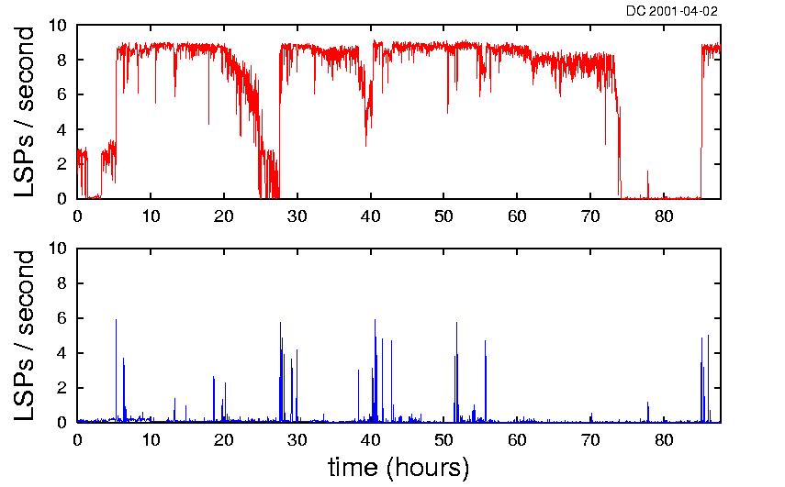
Excessive ISIS churn caused excessive LSP Propagation Delay
All link state packets (LSPs) including refreshes
LSPs that report a change
LSP propagation delay
Seconds between seeing the same LSP in the east and the west coasts of the US

Slide 7
Explanation
Link state databases were not in sync:
Very large LSP databases
High churn rate caused many LSPs to flood
LSP rate-control slowed down flooding
Any topology change could result in a loop under these conditions
We realized being able to look at routing was key for powerful network performance analysis
Today, we see very high churn in very large TE databases using auto-bandwidth with large number of tunnels

Slide 8
Route Analytics Today
Troubleshooting and visualization
Service/application monitoring and alerting
Network health assessment
Topology-aware traffic analysis
Proactive change modeling
Analytics-driven Software Defined Networking applications
Presentation
. . .
Reporting
Alerting
Planning
Trouble-
shooting
Analysis
Path Reports
RCA
Exit Routers
. . .
Traffic Reports
Collection
BGP
IGPs
Flows
Tunnels
. . .
Multicast

Slide 9
Use Case: Diagnosing Black Holing
A peering router to a major service provider crashed
Hot swappable card was not quite so…
Traffic to the SP was black-holed network-wide
Traffic exiting all 6 locations was black-holed
About 3 minutes of routing outage
3 minutes was too short to diagnose the issue at human speed
Had a 45 minute impact on the services and ad revenues
Users who could not use the service did something else

Slide 10
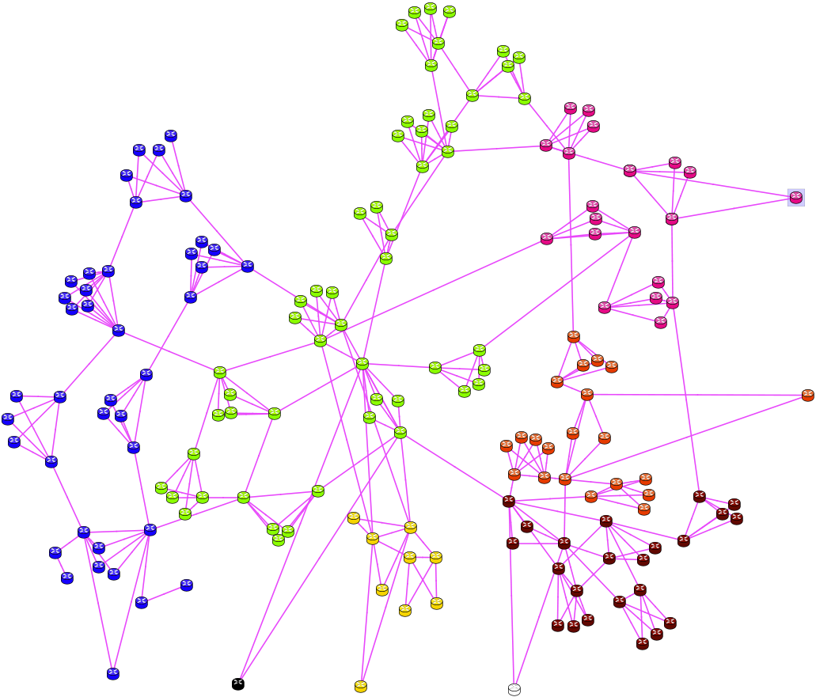
Expected Exit-Points Before Incident
6 Exit-Points (circled)
Blue routers take the blue exit router…

Slide 11
Recursive Route Resolution
BGP determines exits
NextHop attribute
Usually IGP distance determines the closest
More accurately, we recursively find a path to NextHop
IGP, static, BGP, or a series…
IGP
BGP

Slide 12
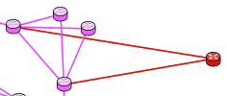
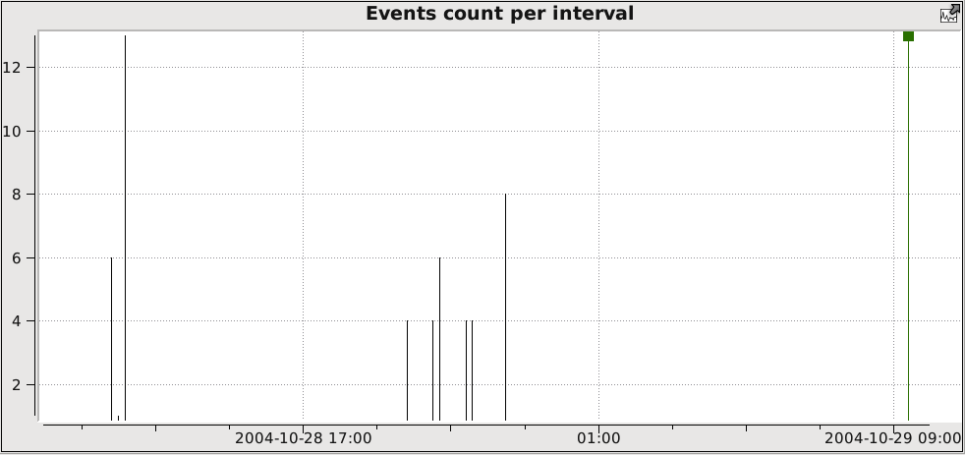
The Incident
ISIS activity during incident

Slide 13
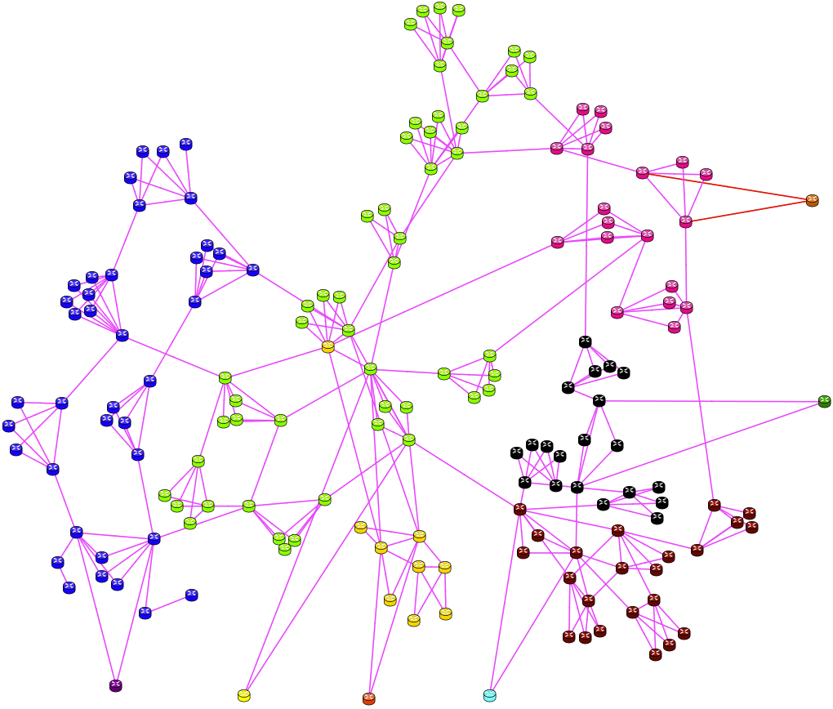
Exit-Points During Incident
6 more exit-points popped up
All core routers
No EBGP

Slide 14
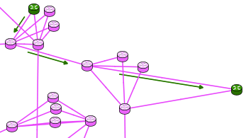
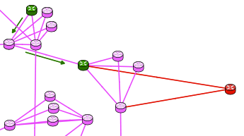
A Path Before and After the Incident
Before
After
BGP Next hop resolution: before 128.9.129.1/32 in ISIS vs. after 128.9.128.0/19 in BGP
Route Recursion

Slide 15
Cause of Black Holing
Every SP announces its address space externally in BGP
128.9.128.0/19 BGP route is for this purpose
But it also resolves the NextHop address 128.9.129.1/32
When the peering router crashed
IGP routes from that router were withdrawn in milliseconds
BGP routes from that router were not withdrawn
3 KEEPALIVEs of 60 seconds each – router rebooted before this
These BGP routes were now resolved by 128.9.128.0/19 in BGP
Injected by 6 core routers
Distance to a core router from any router is very low
Every router uses the dead router’s BGP routes
We are good at designing networks when everything is up and running, but failure cases are often beyond our imagination

Slide 16
Remedy
Insert a really expensive static route for the /19 to ISIS
It should cost more than longest possible path in IGP
ISIS routes preferred over BGP routes and will hide the /19 BGP route in recursion
Now, when a peering router crashes, the traffic will choose a true exit
See: http://www.nanog.org/meetings/nanog34/presentations/gill.pdf
Do not: Make IBGP session converge faster (like running BFD)
One may argue the root cause is that BGP was too slow to withdraw
You will lose the IBGP session each time the IGP path of the session changes

Slide 17
Challenges in Operating SDN
SDN makes networks programmable for
Network overlays
Bandwidth reservation
Demand placement
Service deployment
Etc.
-- but --
Applications
Demand Placement
Service Deployment
Bandwidth Calendaring
ETC.
Northbound APIs
SDN CONTROLLERS
Southbound APIs: OpenFlow, i2RS, PCE, NETCONF, ForCES, SNMP, CLI, etc.
Physical & Virtual Routers, Switches & Network functions
What governs whether or not these programmatic changes should be made? What will be their impact?

Slide 18
Need for Analytics-Driven Applications
When major apps/services are introduced, planning groups validate capacity
Quality of Experience expectations
Capacity planning
Changes to the topology, CoS treatment, …
If the apps/services are being rolled out without operator intervention, how do you plan for them?
SDN analytics addresses this concern

Slide 19
How Rich Analytics Help a Bandwidth Scheduling Application
Bandwidth scheduling: can I move X bps from A to B at time t ?
Attractiveness: SPs have abundance of spare bandwidth
Most SP networks have less than 50% utilization
Verizon: 46% average peak utilization
Level 3: 46-56% peak utilization range
Can an SP profit from this spare capacity?
But there are good reasons for this spare bandwidth

Slide 20
A Naïve Implementation
Let’s collect link utilizations
This is near real time; and SPs already have it
We need utilizations at time t
Use historical link utilizations
Baseline: average same 5-minute or hour of the day for several weeks
Add projections for growth and safety
Compute path from A to B and add X bps to the links
Go or no-go decision based on new link utilizations
If go, schedule the SDN controller to set up this path from A to B at time t, and tear it down afterwards

Slide 21
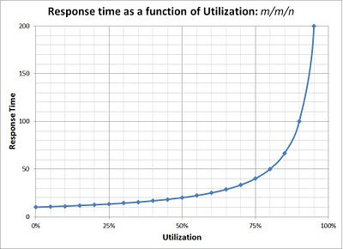
Reasons for Spare Bandwidth
Increased utilization ⇒ increased delay and jitter
Delay vs. link utilization curve has a sharp knee
Network must accommodate failures
Network must have capacity to reroute the traffic around failures
Large networks have one link down at any given time, they must tolerate two link failures
Traffic is growing but adding capacity takes time

Slide 22
Addressing These Challenges
Increased delay
Cap the go/no-go decision at ~65-70%
For anything above that we must be moving bulk traffic
Not suitable for uncompressed HD broadcast of an event
Not even suitable for best-effort traffic
Must deploy differentiated services
Protect against failures via analytics driven simulation
Fail every (or two) link/router and see the impact on link utilizations
Not sufficient to fail just the links/routers along the path

Slide 23
Failure Impact: Where will the traffic go?
We need to know where the traffic is entering the network, how much traffic there is, and where it is exiting the network
Link utilizations don’t tell where the traffic is entering or exiting the network
We need to understand the network’s routing to compute the new paths

Slide 24
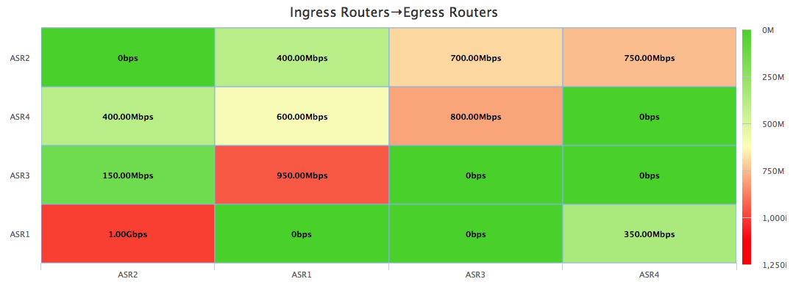
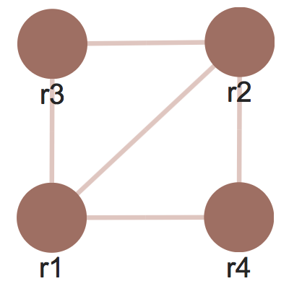
Need for a Traffic Demand Matrix
Traffic Matrix:
For each router pair (r1,r2), how much traffic entering at r1 is exiting at r2?
Flow data coupled with routing gives us traffic matrix

Slide 25
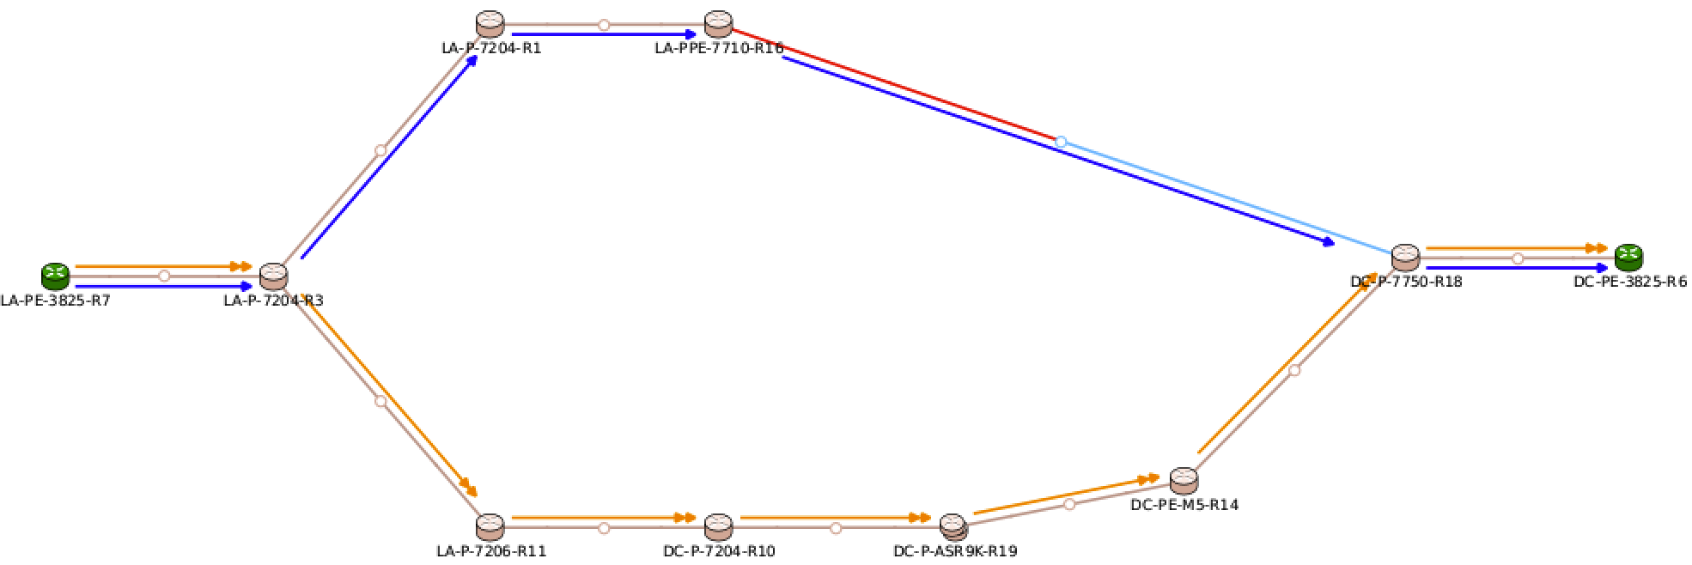
Simulation and Impact of a Failure
For each flow on the failed link
Go to the ingress router and find the new path for the flow
Subtract flow’s bandwidth from the old links
Add flow’s bandwidth to the new links
Check to see if congestion crept in
We need an accurate routing model of the network
Route analytics provides this for IGP, BGP, RSVP-TE, VPNs…

Slide 26
Concluding Remarks
Routing impacts network performance
Availability and reachability
Sub-optimal paths with longer delays, jitter
Route analytics proves to be very effective in
Troubleshooting, monitoring, alerting
Reporting and network health assessment
Routing-aware traffic analysis
BGP peering analysis
Traffic matrices
Rich analytics are key for successful SDN deployment and applications, including bandwidth scheduling

