Slide 1
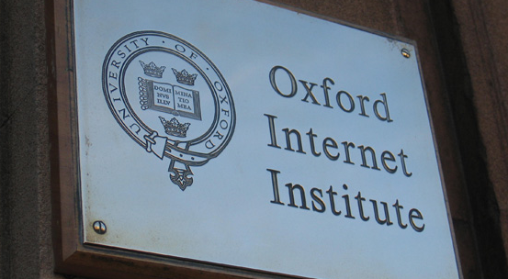
OII

Slide 2
Internet Engineering Task Force
We reject kings, presidents and voting.
We believe in rough consensus and running code.
[David Clarke]

Slide 3
But also,
The IETF’s main goal is to ensure the Internet ‘works better’. The fundamental mission of the IETF can be summed up in this sentence: ‘The community believes that the goal is connectivity, the tool is the Internet Protocol, and the intelligence is end-to-end rather than hidden the network’ (RFC 1958).

Slide 4
Internet hay-days
IETF Community = main users, this has shifted.
Civil society engagement minimal in comparison to other stakeholders in protocol development process.
Impact of protocols on (civil) society is increasing, as the reach and impact of the Internet increases.

Slide 5
So,
There is a clear need to:
1. Get better understanding of the actual impact of standards and protocols on society – intended or not.
2. Investigate possibilities for ensuring that their impact is in line with existing human rights standards/ethical norms.

Slide 6
Research Questions
Could and should human rights be instantiated in protocols?
Is it possible to translate human rights to technical concepts?
How should Civil Society Organizations participate in the creation of standards?

Slide 7
Methods
Elite Interviewing
Participant observation
Discourse analysis of mailing lists + RFCs
This thesis is based on qualitative research that combines elite interviews, participant observation and discourse analysis to present the views and values of technical engineers, and the dangers and possibilities of purposefully introducing human rights into protocols.

Slide 8
Tensions and Tussles
Philosophical:
Who has the power to set standards in standard setting bodies?
Are human rights absolute?
Can standard setting bodies gain the legitimacy necessary to (en)code laws?
Protocol specific:
Should protocols allow space for tussle between different stakeholders?
What about the existing path contingency of technology?
Can human rights be translated to technical concepts?
Practical
How do we ensure all stakeholders are at the table?
How to account for the fact that IETF standards are voluntary?
How do we deal with existing barriers to entry to the IETF [resources, language, education, gender, able-bodiedness etc.]?

Slide 9
Steps
Gather data [interviews etc.]
Synthesize data, extrapolate general themes, hold these up to existing (academic) theories
Bring the findings back to the IETF
Distill lessons and best practices
Start ongoing conversation with the community
[Graduate]

Slide 10
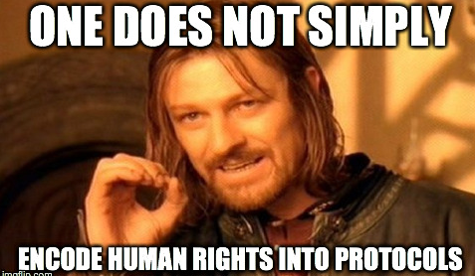
Q & A

