Slide 2
DNS-Based DDoS Evolving Threat RIPE May 2015 Amsterdam
Ralf Weber
Bruce Van Nice

Slide 3
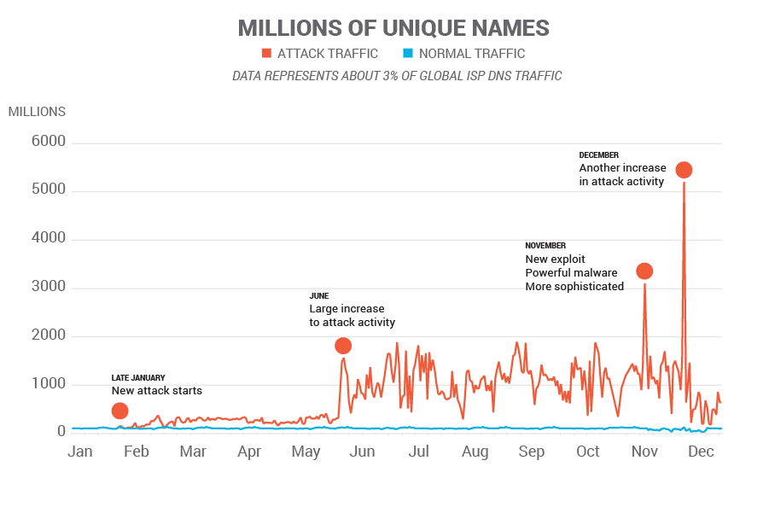
2014 Random Subdomain Attacks
2014 Data

Slide 4
2015 – Quieter in Some Ways
2015 Data
All quiet???
JAN
FEB
MAR
APR

Slide 5
Typical “Day in the Life” DNS Queries Seen at Resolvers
DDoS
Other

Slide 6
Typical Day in The Life DDoS Queries Seen at a Resolver
Amplification
Random
Subdomain

Slide 7
Observations
Use of open resolvers/proxies still predominates
Installed base around 17 M
Trend toward more stealthy attacks - Send enough traffic to bring down authorities
Highly distributed attacks – 1,000s of open resolvers per attack
Often low intensity per IP
Interesting recent example: www.appledaily.com

Slide 8
Observations
Bot based attacks
Tend to be few IPs - tens to hundreds
High to very high intensity per IP - Up to 1000s of QPS/IP - Long tail with lower QPS
Recent interesting example: rutgers.edu

Slide 9
Attacks Using Bots
Target
Web Site
Authoritative
Server
3
NXD
responses
Internet
Bot infected
devices
ISP
2
Recursive
queries
1
ISP Resolver
Queries
with randomized
subdomains
Home
Gateways

Slide 10
What’s Happening?
Network scans for vulnerable devices:
Home gateways or other “Things”
Attempts login with default passwords
Many utilities at the attackers disposal
Load and run malware
Other vectors possible: Bots with loaders, Rompager

Slide 11
The Problem
Considerable stress on DNS infrastructure:
Resolvers Queries require recursion (computationally expensive) Working around failed or slow authorities Stress concentrates as authorities fail
Authorities Unexpected query spikes exceed provisioned limits

Slide 12
Goals for Remediation
Minimize work for resolvers
Eliminate bad traffic to authoritative servers
Answer legitimate queries
Answer legitimate queries for attacked domains
don’t drop, don’t SERVFAIL
Two approaches being used:
Rate limit traffic to authorities
Ingress filtering
How do they behave in practice?

Slide 13
Testing Efficiency of Rate Limiting
Authoritative
Server
Internet
Authoritative Outbund rate limiting
Attack Traffic
ISP Resolver
Inggess policy based filtering
User traffic

Slide 14
Test Diagram
Redwood City, CA
Regensberg, Germany
good traffic
10kqps background
100qps for test domains
2 domains
being attacked
dnsperf
Authoritative
Servers
Resolver
tcpreplay
other
resolutions
100qps
1qps
attack traffic
2 * 5000 qps for
two domains
Rate limits should not be hit for normal traffic
Resolver and authoritative servers record traffic

Slide 15
Run good traffic: User results

Slide 16
Run good traffic: Test domains results

Slide 17
Run good traffic: Authoritative Server Results

Slide 18
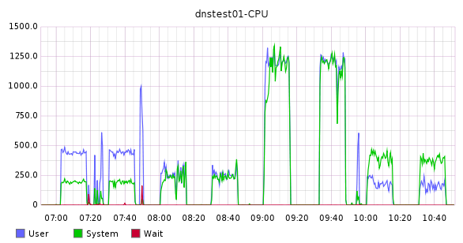
System Stats
Bind
Vantio
Power DNS
Unbound

Slide 19
Run attack traffic – Compare with normal
Notes:
Around 16% Servfail that will be noted by users

Slide 20
Run protected attack traffic: User results

Slide 21
Run good traffic: User results

Slide 22
Run protected attack traffic: Test domains results

Slide 23
Run good traffic: Test domains results

Slide 24
Run protected attack traffic: Authoritiative Server Results
Notes:
Bind unprotected issued only 2 million queries

Slide 25
Run good traffic: Authoritative Server Results

Slide 26
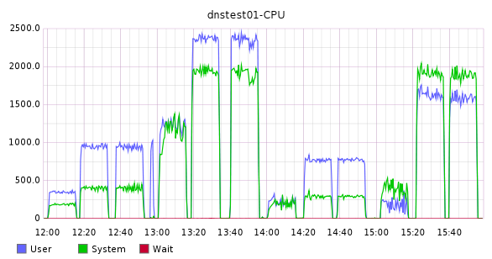
System Stats
Bind
Unbound
Vantio
Power DNS

Slide 27
Results: Resolver Traffic 9,000,000 queries
Resolver | Test run | Type | No Error | NXDomain | Lost | Servfail
Vantio | 3 | Good | 8987622 | 12248 | 74 | 56
 | 5 | Attack | 8988291 | 11576 | 100 | 33
ingress filter | 7 | Attack | 8978049 | 20668 | 1142 | 141
PDNS | 3 | Good | 8989007 | 9477 | 94 | 1422
 | 5 | Attack | 8986967 | 8767 | 2868 | 1398
Bind | 3 | Good | 8986205 | 11537 | 231 | 2027
 | 5 | Attack | 8985913 | 11571 | 371 | 2145
unprotect | 7 | Attack | 7497150 | 19291 | 5436 | 1478123
Unbound | 8 | Good | 8982254 | 17309 | 287 | 150
 | 9 | Attack | 8975942 | 17114 | 901 | 6043

Slide 28
Results: Attack domains
Software | Test Run | Type | No Error | Lost | Servfail | Auth Noerror | Auth NXDomain | Auth Dropped
CS7 | 3 | Good | 89970 | 0 | 30 | 8997 | 0 | 0
 | 5 | Attack | 1450 | 0 | 88550 | 145 | 93684 | 80790
ingress filter | 7 | Attack | 899950 | 0 | 50 | 8998 | 0 | 0
PDNS | 3 | Good | 89929 | 0 | 71 | 8995 | 0 | 0
 | 5 | Attack | 807 | 1395 | 87798 | 99 | 16317 | 62131
Bind | 3 | Good | 90000 | 0 | 0 | 9000 | 0 | 0
 | 5 | Attack | 560 | 2 | 89438 | 56 | 7683 | 6670
unprotect | 7 | Attack | 3310 | 160 | 86530 | 332 | 94315 | 2538256
Unbound | 8 | Good | 90000 | 0 | 0 | 16401 | 0 | 0
 | 9 | Attack | 4311 | 6 | 85584 | 910 | 48110 | 417843

Slide 29
Test Results Summary
 | Ingress Filtering | Rate Limit Authorities
Eliminate bad traffic to authoritative servers | YES | SOME
Correctly answer legitimate queries (don’t drop, don’t SERVFAIL) | YES | YES
Correctly answer legitimate queries for attacked domains | YES | NO

Slide 30
Summary
Constant DNS Based DDoS evolution
Open Home Gateways remain a problem
Malware-based exploits create broad exposure
Not clear where attacks are headed
Evidence attackers refining techniques
Remediation needs to be undertaken with care

