Slide 1
State of African Interconnection & Peering
RIPE 2015
<Andrew Owens> Ripe <2015>

Slide 2
The Good News
30 Operational Exchanges in 22 countries out of 54
Combined Peak Traffic of 52 Gbps
Large Regional Networks e.g. Liquid Telecoms, Seacom, CMC Networks, Telkom, Internet Solutions
Over 700 000km of terrestrial fibre
Reaching 40% of the population
Multiple cables providing over 24 Tbps of landed capacity reaching major business hubs including South Africa, Kenya, Nigeria
Neutral facilities are now a reality
IXP community starting to work together
AF-IX key to this!

Slide 3
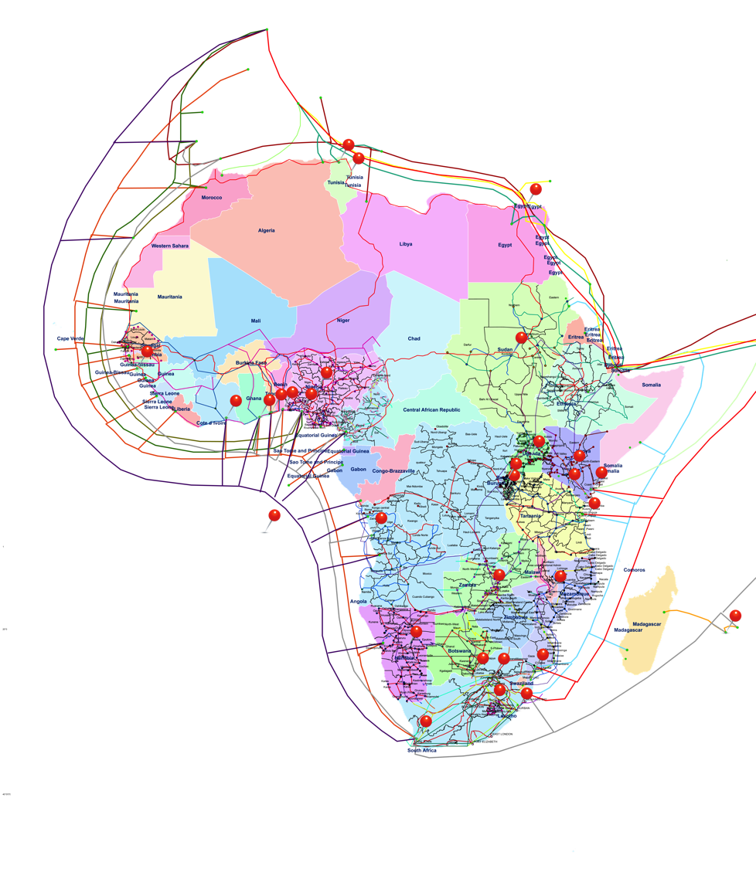
Regional Exchanges are a Reality
Multiple IXP’s in key hubs including South Africa, Kenya and Nigeria
Larger traffic & members in the Capitals than at the landing stations
Yes these exchanges are finally up and to the rights!

Slide 4
IXP Ownership

Slide 5
Peering Options

Slide 6
Commercial Models – IXP’s adding Value

Slide 7
The Bad….
Cost of bandwidth still high but dropping rapidly;
Majority of “eye balls” do not have technical skills or assets therefore still heavily reliant on transit
Majority of countries still operate as a monopoly managed by governments
Limited marketplace to obtain members – new members generally need to be convinced to let go of existing transit arrangements
Existing ASN application process very slow and expensive for new entrants
Interconnection costs high and slow delivery in non neutral environments e.g. Djibouti $18000.00 1Gbps fibre non redundant, Nigeria $2000.00 per cross connect, Kenya $300 per cross connect
Government involved in Regional Exchange points – Market should decide where best to peer
Council power a limited resource e.g. Nigeria, South Africa, Kenya primarily relies on wood fuel & coal;

Slide 8
The Ugly…. Southern African Example
Power, Power Power……
Eskom – Services Southern Africa Region e.g. South Africa, Swaziland, Lesotho etc.
Ongoing Load Shedding – No leadership and 3x over their budget
Two years behind maintenance e.g. Silo collapsed November 2014
Medupi power station was meant to go live in 2013, only at full capacity in 2018 with 6x800MW Turbines – only just meet current demand;
Annual power Cost of power estimated more than CPI;
Reality is additional Council power only ready in 2019 which can only meet current demand

Slide 9
The Ugly…. Kenya Example
Already at 80% of power demand with underestimated annual growth

Slide 10
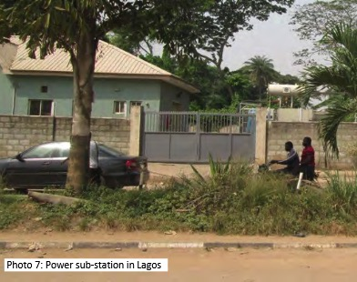
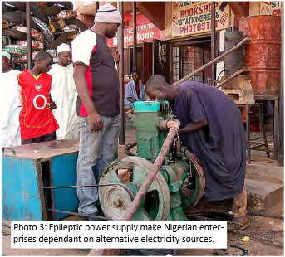
The Ugly…. Nigeria Example
Roadmap provides for 40,000MW by 2020, were 200,000MW is actually required to sustain growth
Currently delivering 4,400MW which peaks at 4,517 MW with a short fall of over 1,482MW
Alternative Energy is key to the survival

Slide 11
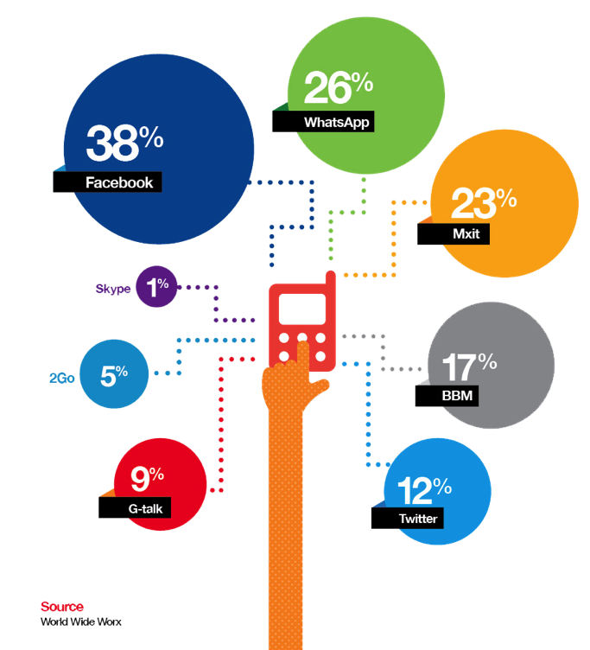
Massive opportunity but always double check
Put your SLA to the test on power and Interconnection
Truly Neutral Data Centres key to IXP growth
Work together with Data Centre operators for best transport costs
Reduced IP transit fees – innovation required

Slide 12
Thank you – Questions? andrew@teraco.co.za
<Michele McCann> <GPF> <2015>

